Slide 1
Coordination in the High-Energy Sky: Fermi
Liz Hays
NASA GSFC

Slide 2
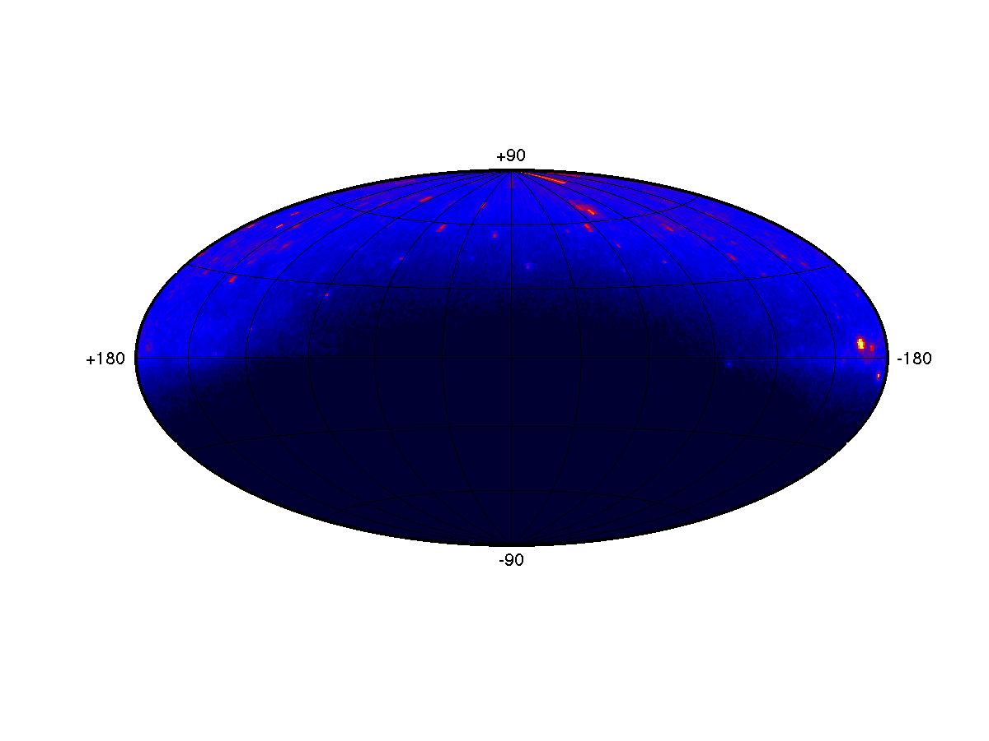
Fermi Observations
Extremely wide field, high cadence observations.
Fermi GBM
8 keV – 40 MeV
Instantaneous FOV: unocculted sky
Time to full coverage: ~1.5 hrs
Fermi LAT
20 MeV - >300 GeV
instantaneous FOV: 2π sr
Time to full coverage: 3 hrs for standard survey

Slide 3
Coordination with Fermi
Passive: If you want to know about a position in the sky, Fermi probably has data close to the time you care about.
Data collected >80% of the time (instruments do not acquire data in the South Atlantic Anomaly)
Performance described here and SSC or instrument team members can help with understanding sensitivity needs for sources
Active: Mission plans calibration activities to avoid reported multiwavelength campaigns, e.g. EHT, VHE campaigns
Survey instrument with data public immediately -- coordination mostly about rapid communication and knowledge sharing.

Slide 4
What did Fermi see?
Rapid results through GCN notices and circulars for transient detections and follow up as well as automated LAT flare alerts from daily searches.
Daily reports of interest in Astronomer’s Telegrams with LAT point of contact for the source (Friend of the Source).
Daily and weekly quicklook lightcurves published for a few hundred sources.
Lightcurve library in progress to provide updated, publication quality, mission-length lightcurves on several time scales for most of the LAT catalog.
Many existing catalogs available for correlation studies – more in progress.
Collaboration with the teams is encouraged. In some cases, MOUs have been developed. In other cases, collaborative efforts organized around a specific paper.
Multiwavelength coordinator, Dave Thompson, provides a general point of contact for multiwavelength and multimessenger coordination activities, queries, suggestions, etc.

