Slide 1
Rubin Observatory Data Rights Policy Ranpal Gill Head of Communications Office Transients 2020 February 3 – 7, 2020
ranpalgill

Slide 2
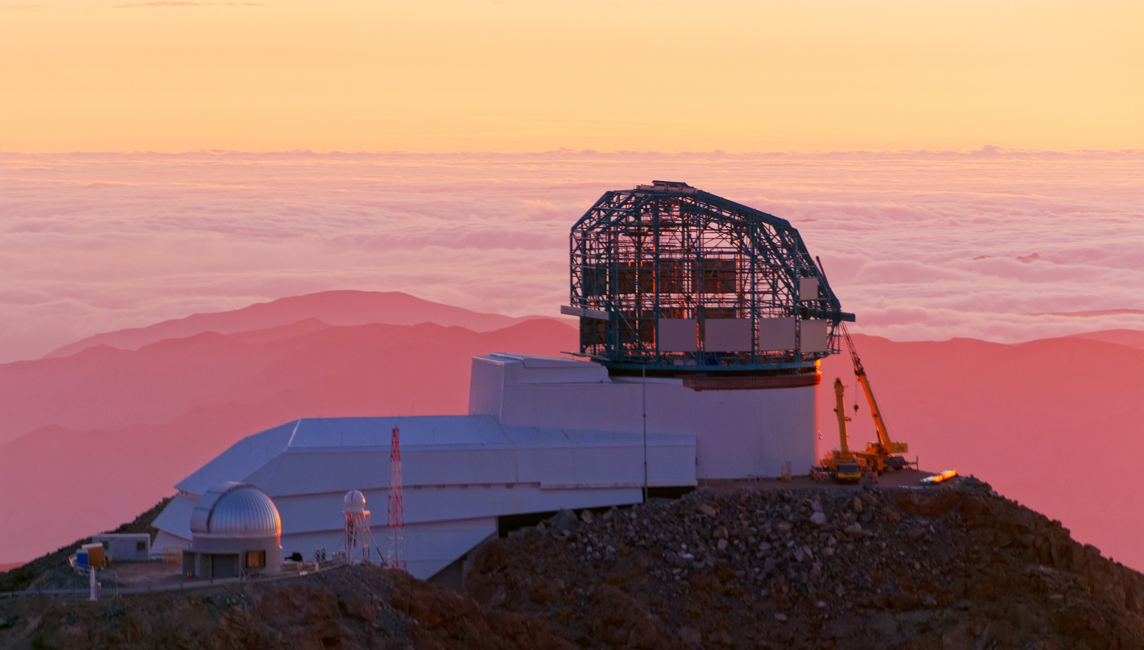
Overview
Rubin Observatory’s mission is to build a well-understood system that provides a vast astronomical dataset for unprecedented discovery of the deep and dynamic universe.
https://gallery.lsst.org — for a live webcam visit https://www.lsst.org/news/see-whats-happening-cerro-pachon
Credit: Rubin Obs./NSF/AURA

Slide 3
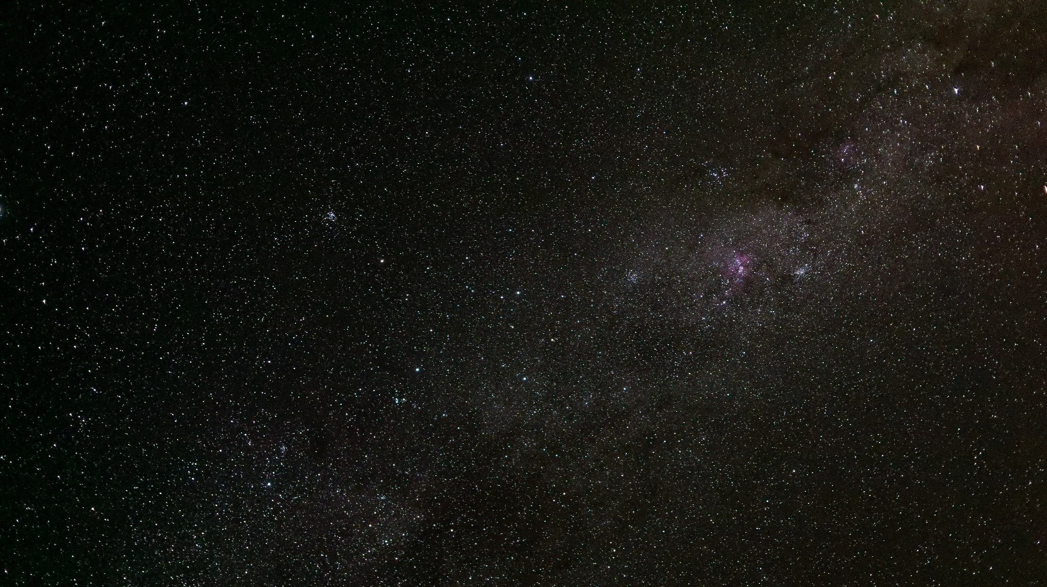
Nightly alerts on ~10 million time-domain events
Final catalog of ~32 trillion observations
~40 billion objects observed over 10 years
~5 million 3200 megapixel images
Annual data release
15 Petabytes final catalogue
Credit: Wil O’Mullane/Rubin Obs./NSF/AURA
Notes:
40 billion objects – 1% of the observable universe

Slide 4
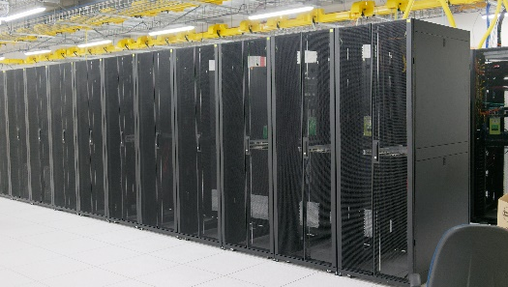
Overview
Credit: Wil O’Mullane/Rubin Obs./NSF/AURA

Slide 5
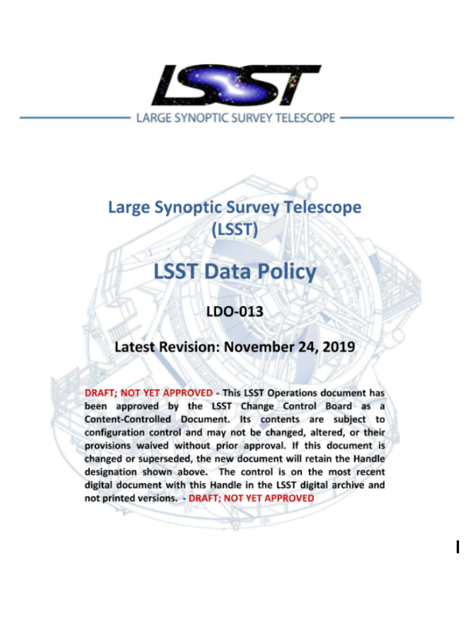
Data rights overview
10m Alerts every night for anyone – very rare!
Small bodies and asteroid data -> Minor Planet Center
US scientists -> full data rights
In-kind partners (Chile, Brazil, IN2P3) -> full data rights
Current International Memorandum of Agreement (MOA) Data Rights holders remain -> new agreement by June 2021
New In-kind contributions in exchange for data rights
Data public after two years
Data Rights Policy Document
http://ls.st/LDO-13
Notes:
In-kind – offset operational cost or add value.
How propriety data can be accessed and used by the our science community who can access, what they can do and how they can publish, how rights holders can collaborate with non rights holders

Slide 6
Benefits/Drawbacks
Benefits
First science papers from funding agency country
Demonstrates return to tax payers
Provides opportunity for international members (In-kind)
Manages proprietary nature of the data while maximizing the science that people can perform
Drawbacks
Complicates science across borders
Smaller institutions/less developed nations loose out

Slide 7
Facilitate International Collaboration
Choice of how to fund the project drives the nature of the international collaboration
Open collaboration between data rights holders
Non-data rights holder can propose in-kind contribution
Limited collaboration through derived data products (LDO-13)
Notes:
telescope time – value to US science

