Slide 1

SiTian project
A world-wide network of telescopes
to explore the fast-variable optical sky
Roberto Soria
Project leader: Liu Jifeng
National Astronomical Observatories
Chinese Academy of Sciences

Slide 2
Fast-variable optical sky still mostly unexplored
(adapted from Kulkarni 2012)
WD collapse
SN shock breakout
Tidal disruption events
Kilonovae
Ultraluminous X-ray bursts
Stellar flares

Slide 3
Example: optical transient of LIGO event
(Cowperthwaite et al. 2017)
NS-NS merger

Slide 4
Example: ultraluminous X-ray transients
(Irwin et al. 2016)
Mysterious X-ray flare
from a globular cluster
in NGC 4697

Slide 5
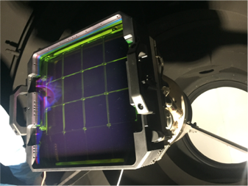
Current state of the art:
Zwicky Transient Facility (ZTF, ex PTF)
1.2-m Schmidt telescope at Palomar (g,r,i filters)
Field of view = 47 sq degrees
3750 sq degrees/hr
20.4 mag reached in each scan (30-s exposures)

Slide 6
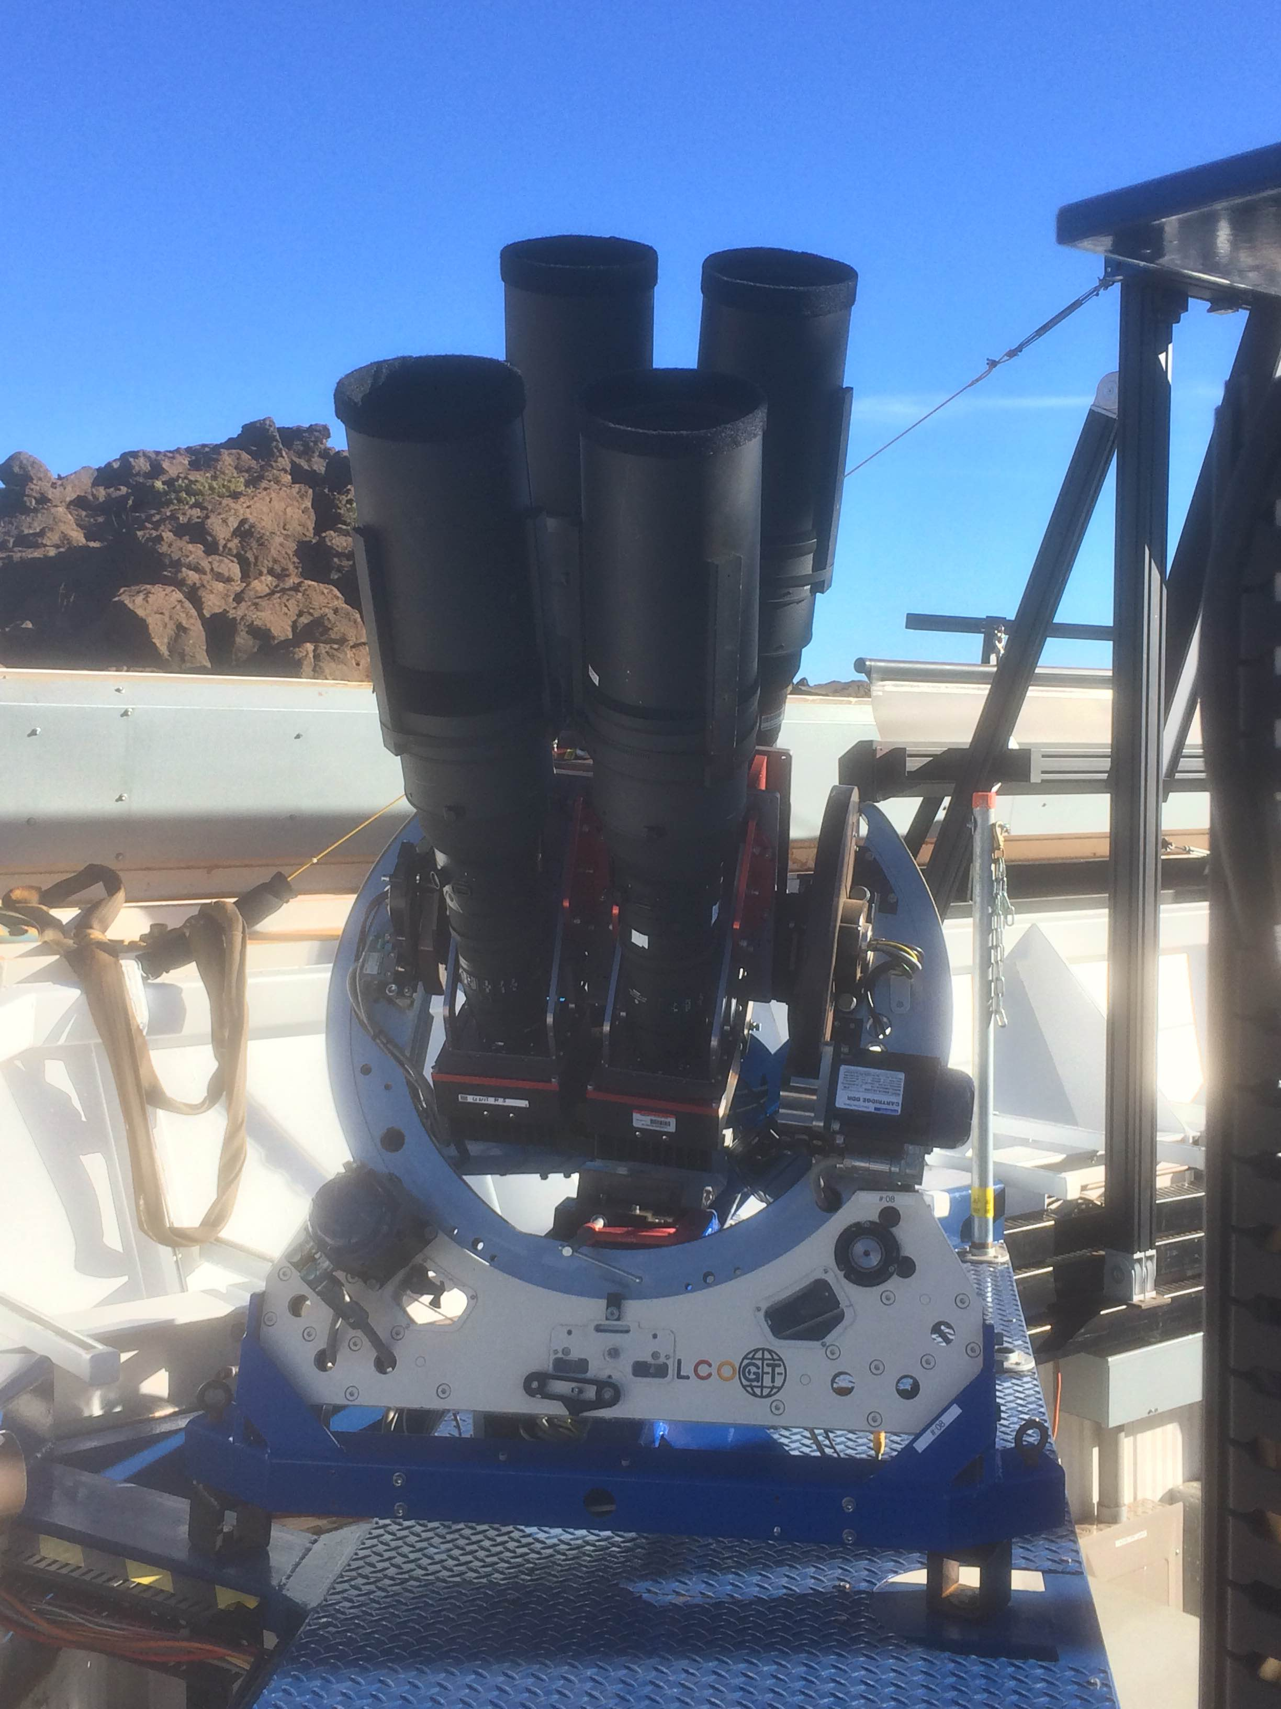
Current state of the art:
ASAS-SN (24 14-cm telescopes, V band)
Six units of 4 telescopes each
2 units in Chile, 1 in Hawaii, 1 in South Africa (Sutherland),
1 in Texas, 1 in China (Tian Shan)
Whole sky once per night
V ~ 18 mag reached each night
Pixel scale: 8”/pixel

Slide 7
Several other monitoring projects planned
DREAMS (PI Anna Moore, ANU)
Infrared monitoring (JHK), 50-cm telescope
All Southern sky every 3 nights

Slide 8
Several other monitoring projects planned
WFST = 2.5m Wide-Field Survey Telescope
(University of Science and Technology of China)
6000 sq deg per night, 30s exposures
30s limiting mags: ugriz = [22.3, 22.9, 22.8, 22.0, 21.0]
All Northern sky every 3 nights

Slide 9

WFST = 2.5m Wide-Field Survey Telescope
Linghu site, elevation 4000m, seeing usually better than 0”.4
Survey operations to start in 2023

Slide 10
SiTian = system of optical telescopes
to explore new regions of time domain
All-sky monitoring (North and South)
1-m telescopes installed world-wide
Full scan of the sky every 30 min
Simultaneous 3-color images (g,r,i)
21.5 mag reached in each scan
Good image quality (1”/pixel)
Spectroscopic follow-up with 4-m telescopes
Sitian-I: 72 1-m telescopes, of which 60 in China
Sitian-II: 72+ more telescopes, worldwide

Slide 11


SiTian project =
telescopes network + computing brain
Sitian-I network:
24 units of three 1-m mirrors (g,r,i)
Schmidt optics, 5 deg x 5 deg FOV
Fully automated, 60-sec exposures
Three 4-m telescopes
for spectroscopic follow-up
Sitian brain:
Operation planning and control of each unit
Data processing and management
Decisions on fast alerts and follow-ups

Slide 12
Sitian working mode
Strategic planning
Sky survey
Alerts
Operational control
Online processing
1-m telescope arrays
Telescopes for follow-ups
Offline
Data
management
Data
processing
processing

Slide 13
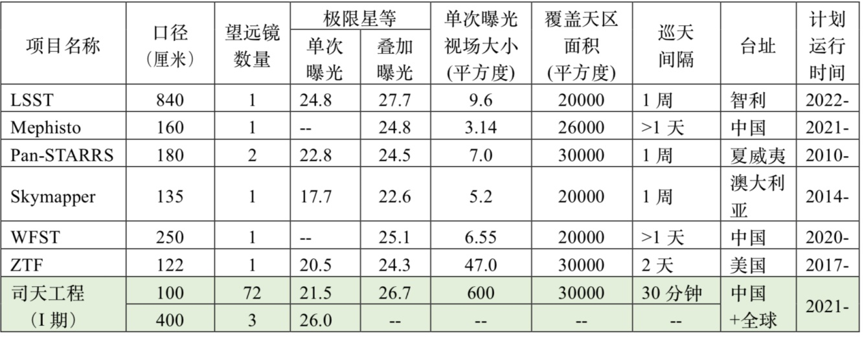
Faster-deeper-wider
than other optical surveys
Detection limit
Project
Number
of
‘scopes
FOV single
exposure
(sq deg)
Aperture
(cm)
Single
scan
Stacked
Sky
coverage
(sq deg)
Cadence
Site
Year
1 week
Chile
>1 day
China
1 week
Hawaii
1 week
Australia
>1 day
China
2 days
USA
Sitian-I
600
30 min
China +global
~2030

Slide 14

Planned world-wide location of Sitian units
Spain
USA
China
Australia
South Africa
Chile

Slide 15
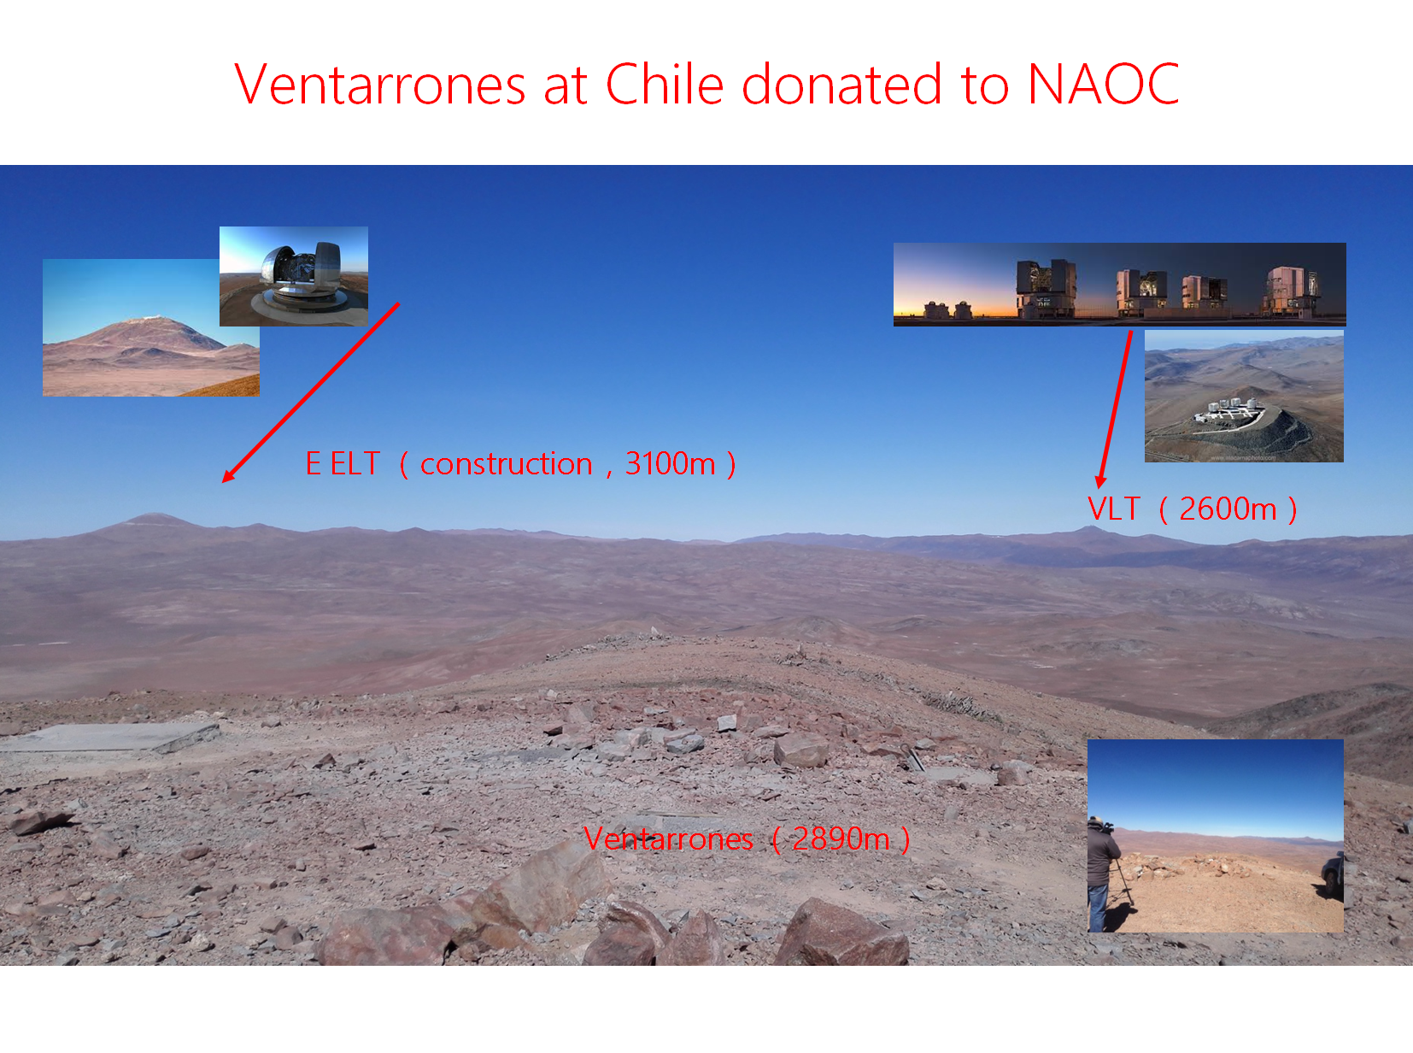
Cierro Ventarrones available for SITIAN units
Agreement through the South America Center for Astronomy
of the Chinese Academy of Sciences (CASSACA)

Slide 16


Slide 17
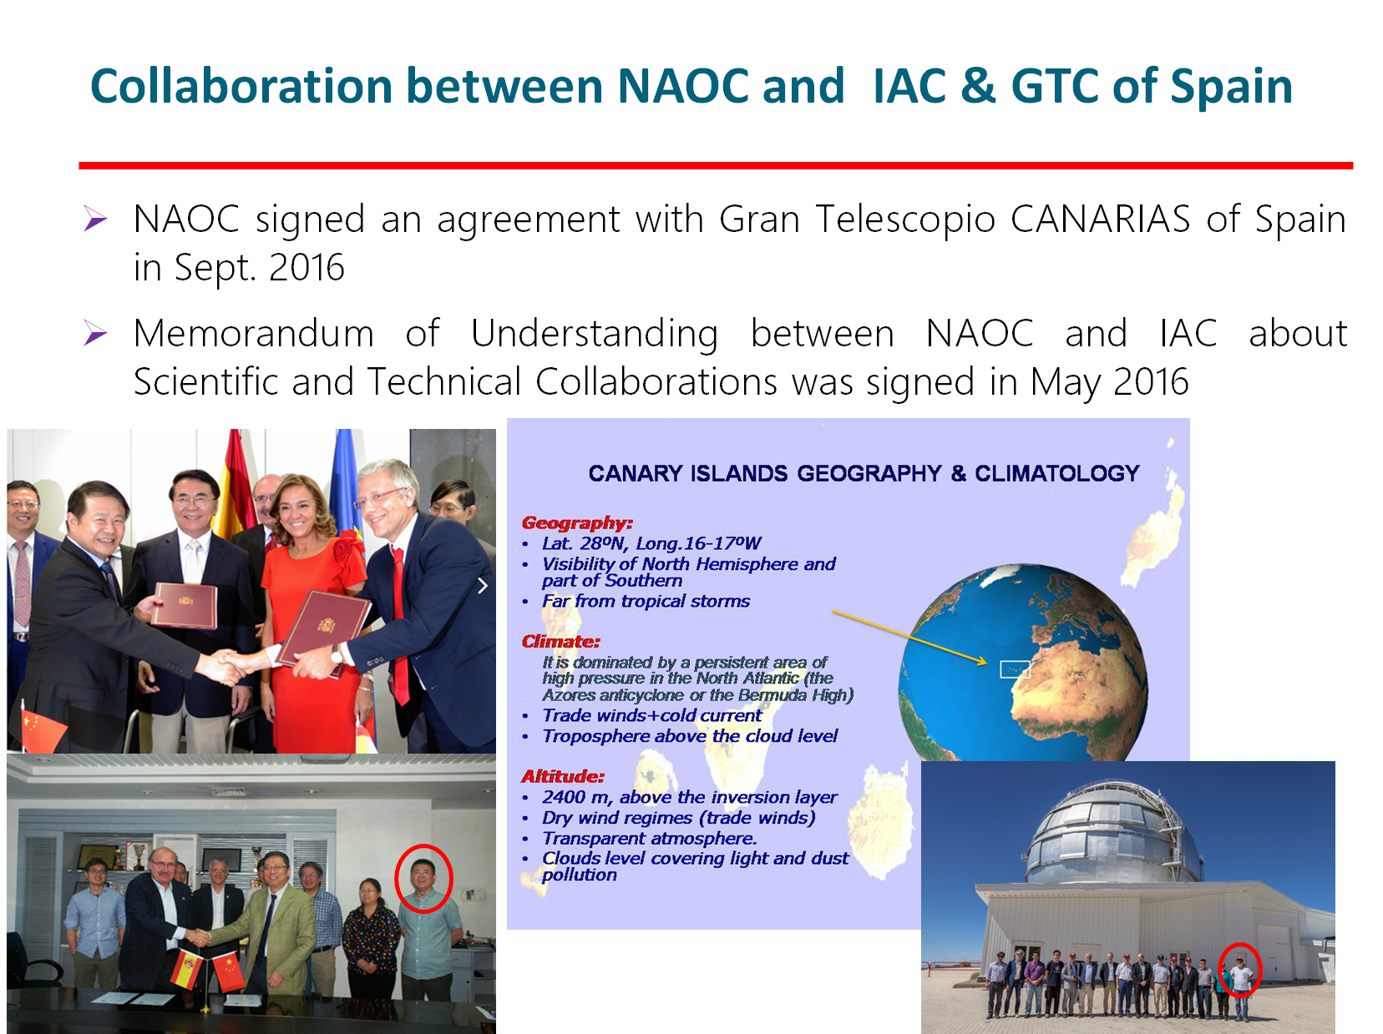
Site: Teide + operation + Science
Rafael Rebolo
IAC director

Slide 18

2019 ACAMAR meeting in Melbourne
Site: SSO + operation + Science
Jeff Cooke
Anna Moore

Slide 19
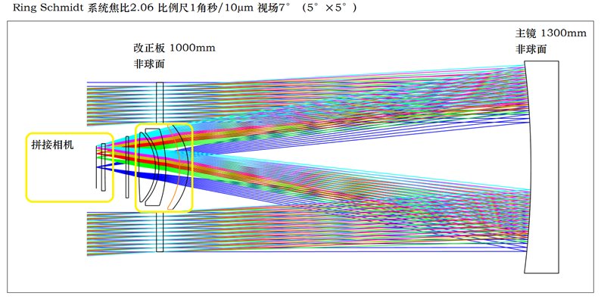
Technical specs of the 1-m telescopes
CCD/CMOS camera
Diameter of primary mirror = 1.3m
Diameter of correction plate = 1.0m
Focal ratio = 2.06
80% encircled energy within 1”.4
Pixel size = 1” (10μm)

Slide 20
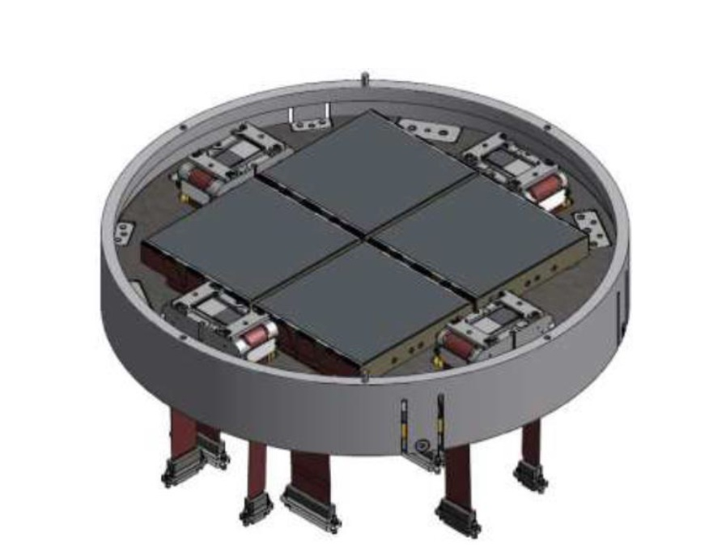
Cameras for the 1-m telescopes
Early design: CCD detectors
Field of view = 5 deg x 5 deg
Pixel size = 1”
Mosaic of four 9k x 9k CCDs in the focal plane
Low readout noise (<~ 5e- at 500 kHz)
Operating temperature ~ 170 K
Better solution: sCMOS detectors
scientific-grade Complementary Metal–Oxide Semiconductor

Slide 21
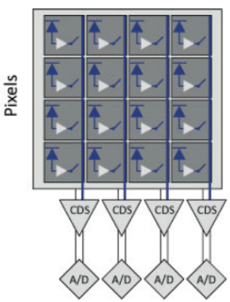
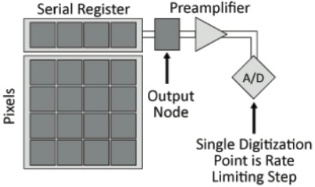
CCDs versus sCMOSs
CCD: single output node to the analog-to-digital converter (ADC)
sCMOS: one ADC
at the end
of each pixel column
Global shutter
Longer readout time
Rolling shutter
Shorter readout time

Slide 22
CCDs versus sCMOSs
Advantages of CCDs:
Higher quantum efficiency (factor of 2 advantage)
Mature technology
Advantages of sCMOSs:
Cheaper (1.2 million $ per unit vs 2.5 M with CCDs)
Lower readout noise (factor of 5)
Faster readout (factor of 50)
No mechanical shutters (longer life)
Lower power consumption
Smartphone cameras are driving CMOS technology
sCMOS detectors will replace CCDs on major telescopes in 5—10 yrs

Slide 23
CCDs versus sCMOSs
Schildknecht et al 2013
Improved Space Object Observation Techniques using CMOS Detectors

Slide 24
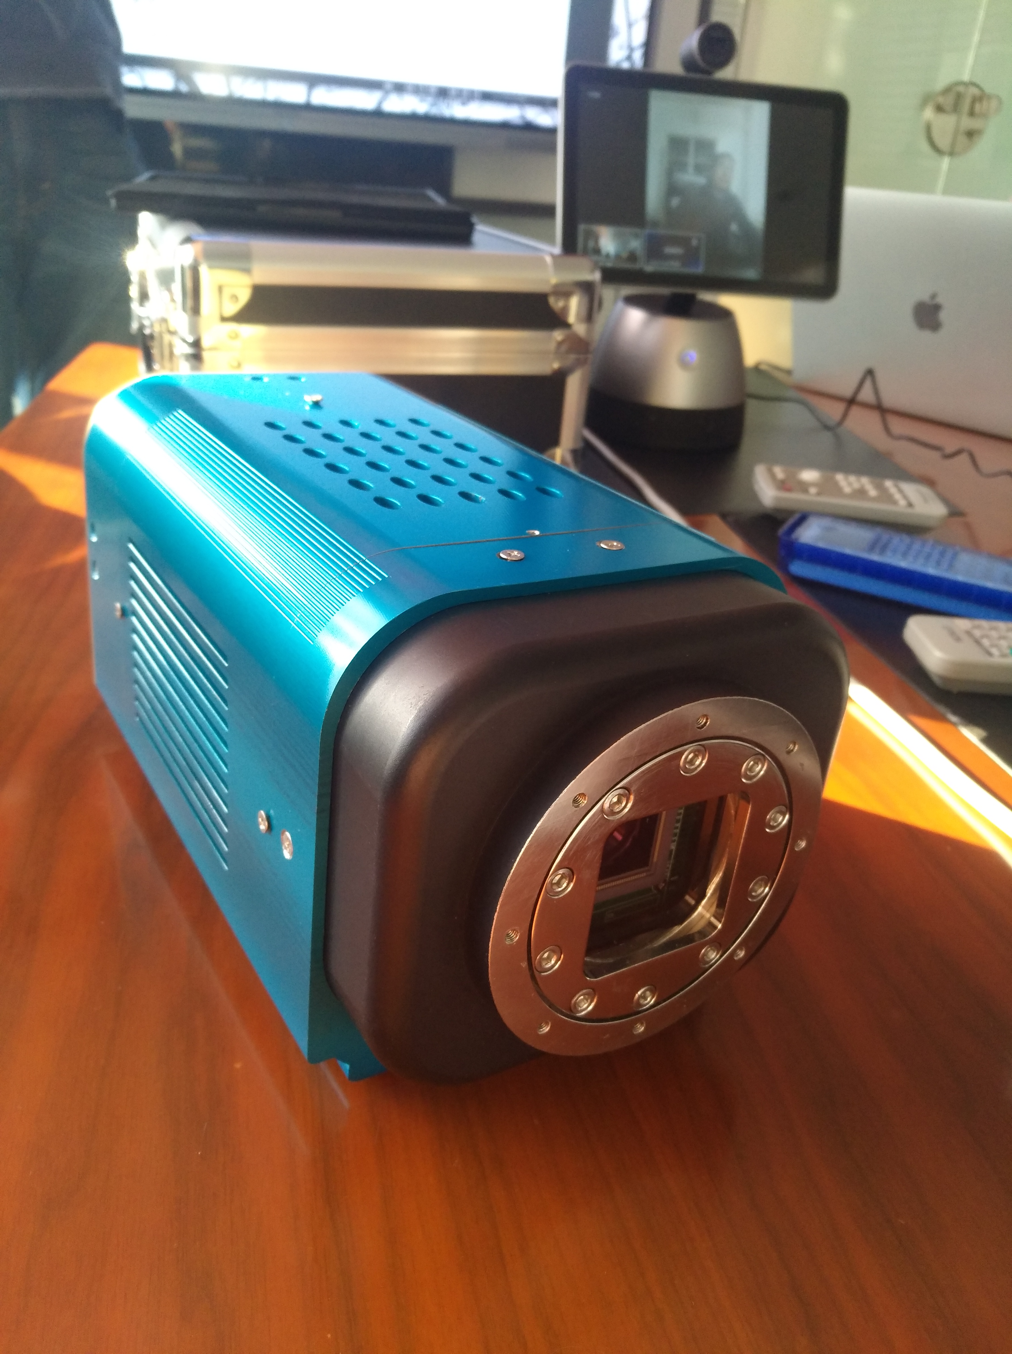
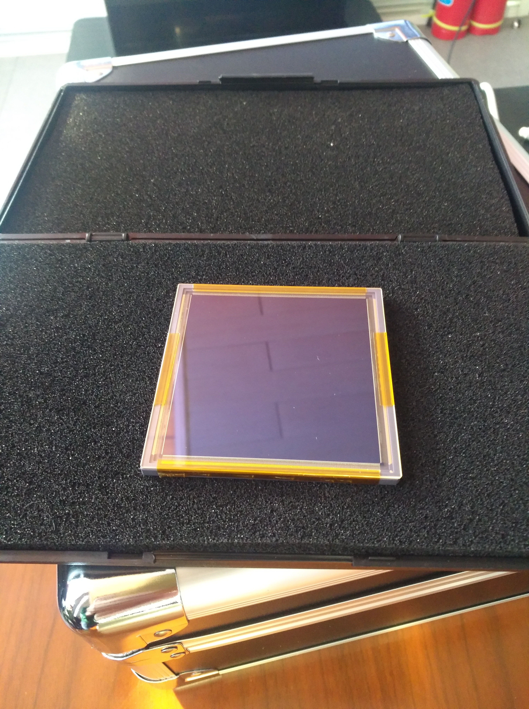
First sCMOS camera ready

Slide 25
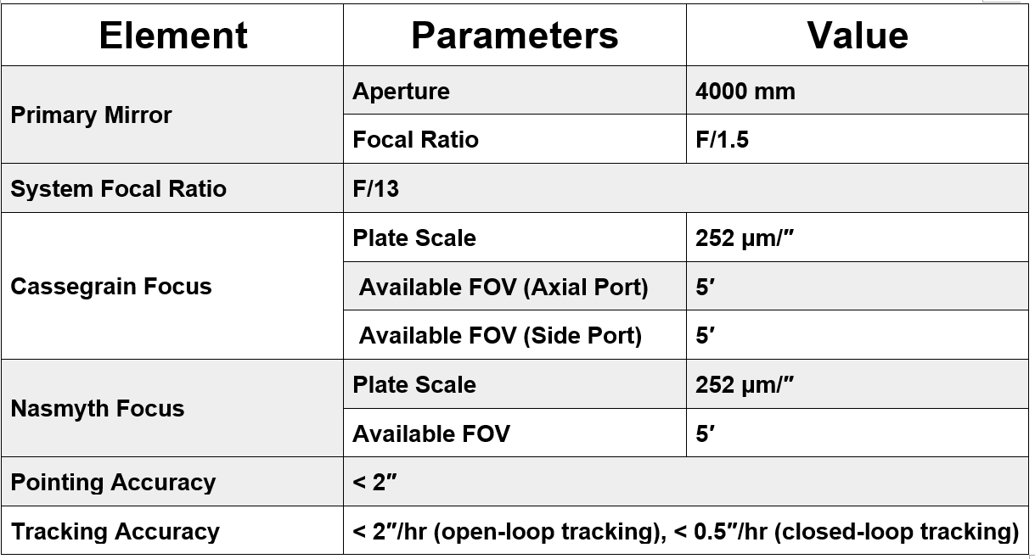
Technical specs of the 4-m telescopes

Slide 26
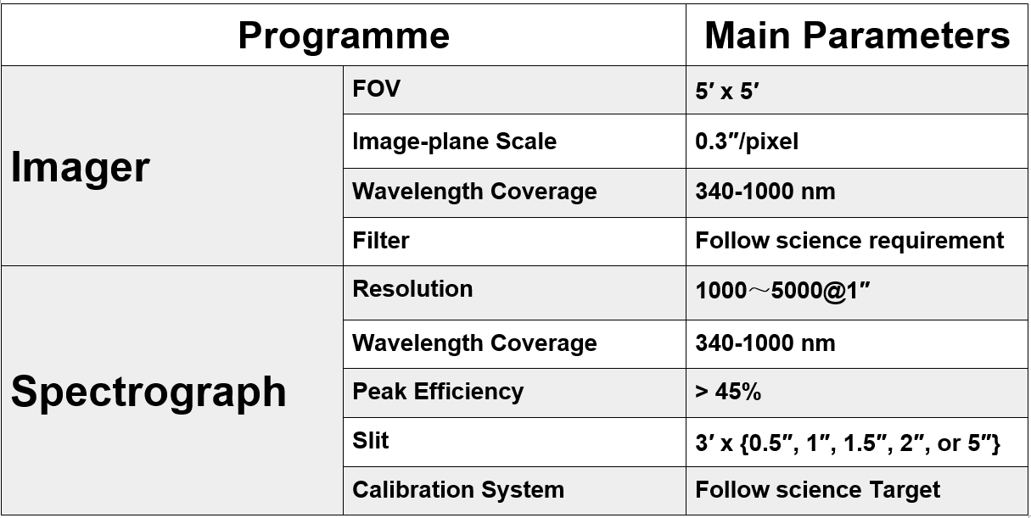
Instruments on the 4m telescopes

Slide 27
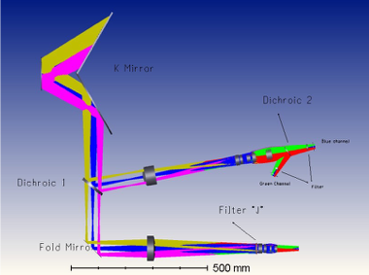
Optical/IR imager on the 4m telescopes

Slide 28
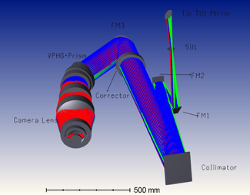
Spectrograph on the 4m telescopes

Slide 29
Summary of main science objectives
Optical counterparts of GW events
Tidal disruption events
Gamma-ray bursts
Fast radio bursts and fast X-ray bursts
Early evolution of supernovae
Accretion-induced white dwarf collapse
AGN and X-ray binary outbursts
Stellar flares
Exoplanets
Microlensing
Near-Earth asteroids

Slide 30
Timeline and budget for SiTian-I
2020—2026: overall design layout
2026—2029: hardware and software testing
2029: complete infrastructures, start installation
2030: complete installation of all 72 telescopes
2032: full scientific operations
Network of 72 telescopes → US$ 300 M
Follow-up 4-m telescopes → US$ 100 M
SiTian brain → US$ 60 M

Slide 31
Next steps for design and testing
Simulations to optimize science requirements
  why 30 min? why 21 mag? which 3 colors?
Get technology ready
  Reduce the telescope cost: $1.7M → $1.4M
  Camera: CCD → CMOS
Define and develop Sitian brain
Build prototype unit for demonstration
Option 1
-- Optics + Mount by CIOMP
-- Mosaic CCD camera (2X2 9K E2V) by Tibet Univ
  Option 2
    -- Optics + Mount + Mosaic CMOS (2X2 8K E2V)
    by Wuhan Univ

Slide 32
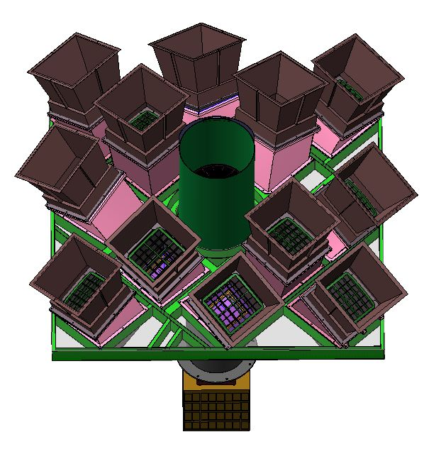
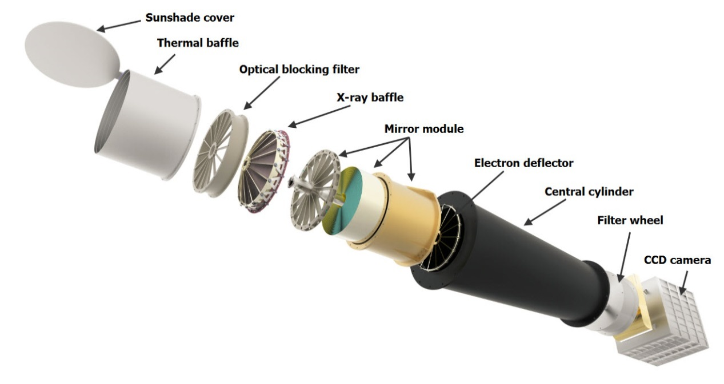
Multiband perspective
NAOC also involved in all-sky X-ray monitoring
Einstein Probe satellite
To be launched in 2022 or 2023
Planned operation = 5 years
Wide-field X-ray Telescope
Follow-up X-ray Telescope

Slide 33
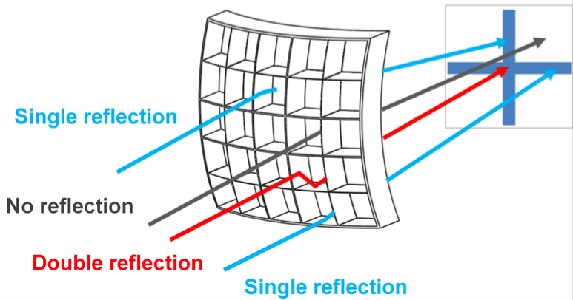
Multiband perspective
NAOC also involved in all-sky X-ray monitoring
Einstein Probe satellite
To be launched in 2022 or 2023
Planned operation = 5 years
Lobster-eye optics → field of view of 3600 sq degrees
All-sky monitoring every 6 hours

Slide 34

Thank you!
Contact jfliu@nao.cas.cn to find out more

Slide 35
Discussion about data rights (1/2)
Full and free data rights for:
  NAOC [and all Chinese institutions?]
  Other institutions where telescopes are installed
  [or the whole host countries?]
Full data rights to other groups:
  in exchange for in-kind or money contributions
  Proposed fee ~ $25,000 per group per yr
  “Group” = 1 senior + 4 junior researchers
Two levels of data rights for paying groups:
A: just access to raw data
B: use of software and other computational resources
Full data rights come with 2-yr proprietary rights
[For all groups or only a subset for each project?]

Slide 36
Discussion about data rights (2/2)
Suggestion for handling proprietary data:
  Full members can propose to create and lead project
  Full members can choose to participate to any project
  Each project will have a recognized leading team
  [Minimum threshold of scientific participation to join?]
  Leading team in charge of communication of results
Data to become public to all after 2 years?
[Different opinions. Needs to be discussed]
Alerts will be public, not data related to the alerts
[Should lightcurves and other results be public?]
Use LSST as a model for data rights?
Agree common data policy with BRICS network?

