Slide 1
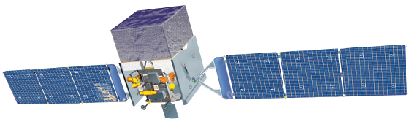
Fermi: Lessons Learned
Liz Hays
Transients 2020

Slide 2
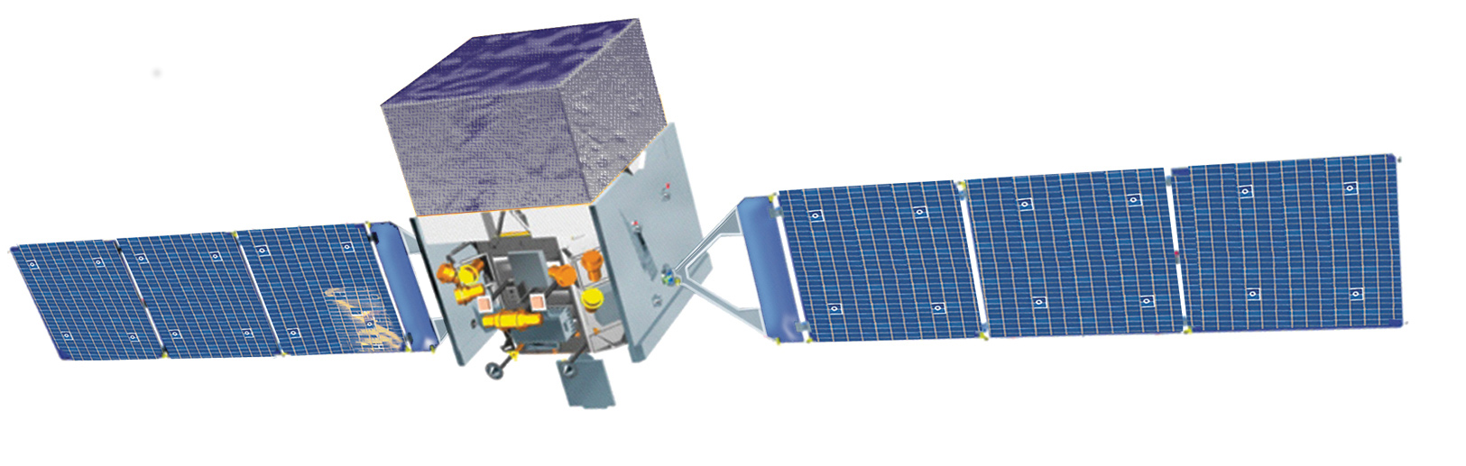
Fermi Observatory
NASA Probe class mission to study the extreme high-energy Universe
Large Area Telescope (LAT):
20 MeV to more than 300 GeV
Views 20% of the sky at any instant
entire sky every 3 hrs
Gamma-ray Burst Monitor (GBM):
8 keV to 40 MeV
Views entire unocculted sky
International and interagency collaboration between NASA and DOE in the US and agencies in France, Germany, Italy, Japan and Sweden
All photon data are publicly available immediately
Analysis tools and supporting resources publicly available
Community involvement
  NASA grant program provides funding to US Investigators
2

Slide 3
The Hitchhiker’s Guide to Transient Searches with a Survey Instrument
Search the sky and find a source
Report it
Science happens!

Slide 4
Lesson 1
All-sky monitors are extremely powerful tools when they provide sufficient sensitivity and localization

Slide 5
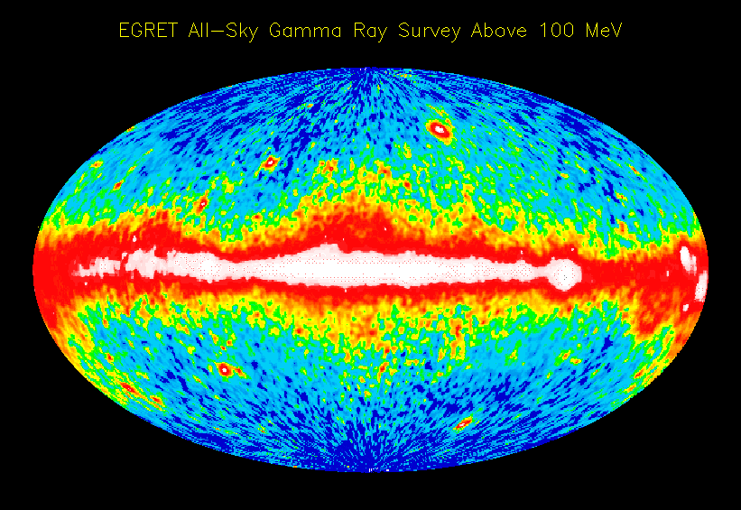
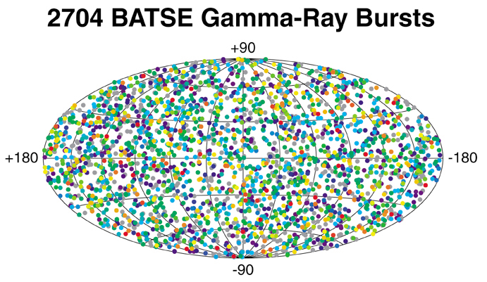
The Dynamic Universe
Notes:
Transient and variable processes -> transient and variable gamma ray sources
EGRET on CGRO opened one of the doors to the transient Universe
But it left many questions.
BATSE opened another.

Slide 6
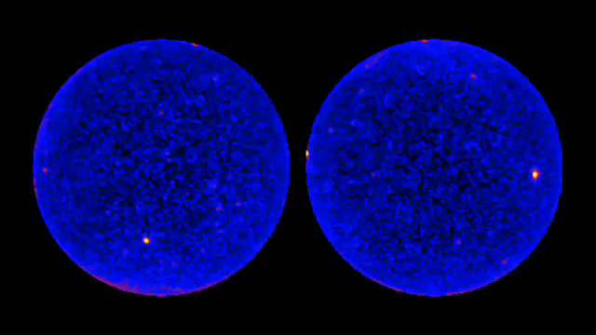
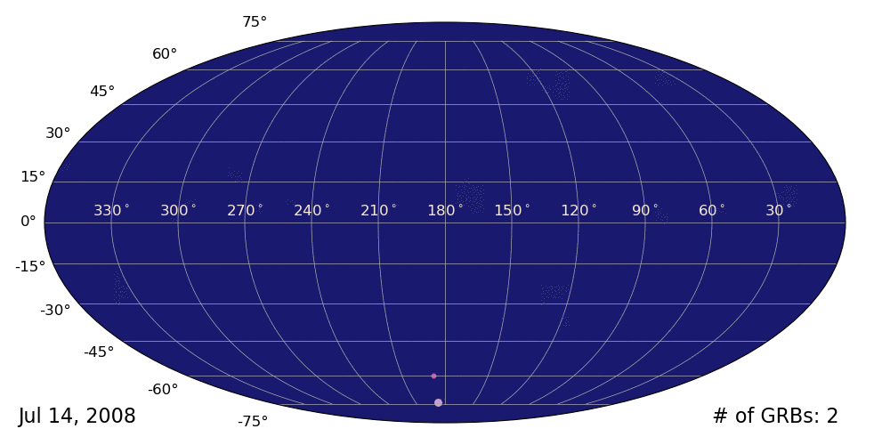
The Dynamic Universe
Daily movie of the Fermi-LAT sky
2704 Fermi-GBM bursts
~26% of the sources in the 4th LAT catalog are classified as variable
Notes:
Gamma rays are not the only tool for finding extreme events, but they are a particularly decisive indication of non-thermal activity.

Slide 7
Broad roles for all-sky gamma-ray monitoring
Find and report new sources or notable changes in known sources
Archive source activity
Characterize nonthermal mechanisms

Slide 8
Broad roles for all-sky gamma-ray monitoring
Find and report new sources or notable changes in known sources
Archive source activity
Characterize nonthermal mechanisms

Slide 9
Notes:
Search everywhen

Slide 10
Lesson 2
Automate where possible
  Deploy human evaluation wisely – we often don’t know exactly how to look for new things.

Slide 11
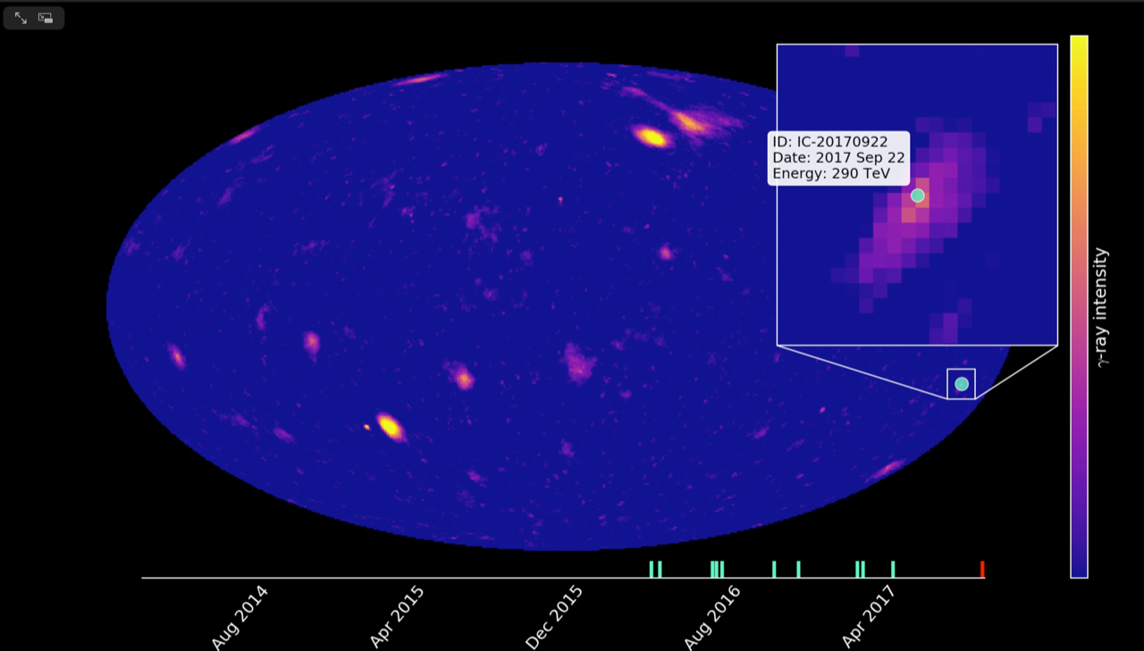
Monitoring success
E.g. identified blazar TXS 0506+056 as a candidate counterpart for a high energy IceCube neutrino alert
Gamma-ray observations are also an important component of triggering more extensive multiwavelength campaigns

Slide 12
Beware
Just because there is a gamma-ray source in a neutrino error region does not mean it is a good candidate counterpart

Slide 13
Roles for gamma-ray observations
Find transient and variable sources
Archive source activity
Characterize nonthermal mechanisms

Slide 14
Lesson 3
Gamma-ray observations have proven highly useful for picking out an active, nonthermal source candidate in a moderately-sized error region

Slide 15
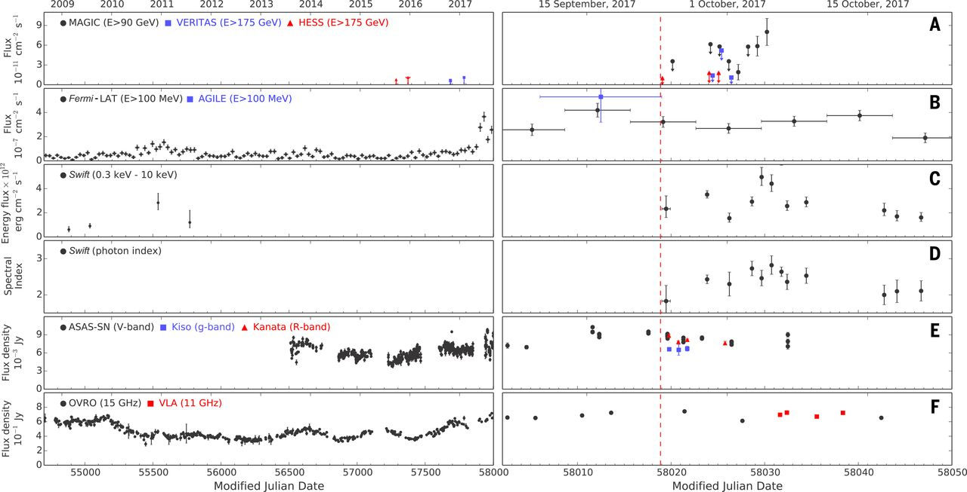
A Source with a History
Notes:
lightcurve

Slide 16
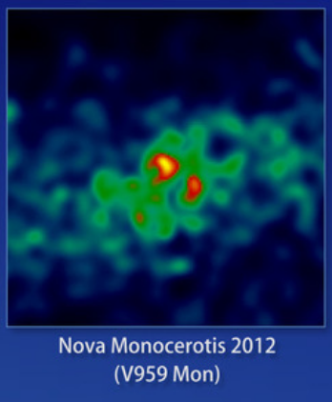
Another fun example
Gamma-ray discovery of Nova Mon 2012 preceded optical measurements by 50 days due to proximity to the Sun.

Slide 17
Roles for gamma-ray observations
Find transient and variable sources
Archive source activity
Characterize nonthermal mechanisms

Slide 18
Fermi covers a huge swath of the spectrum,
all of it accessing nonthermal processes
Notes:
Fermi all-sky movie

Slide 19
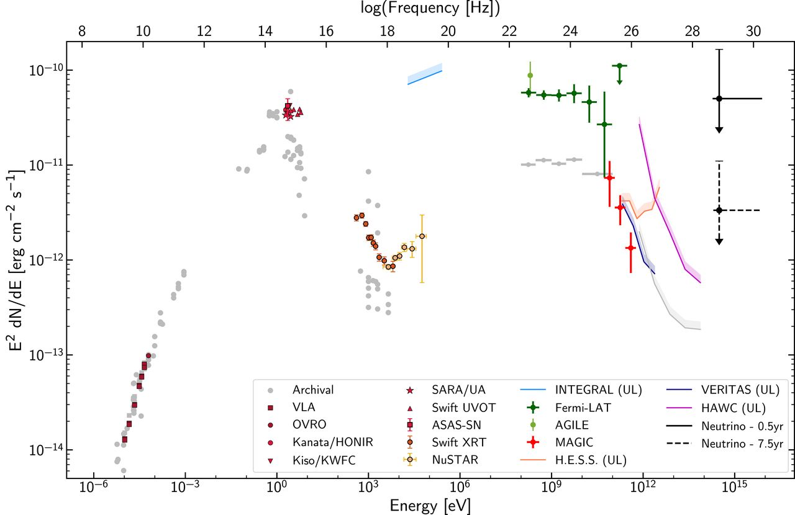
Fermi-LAT observations in context
Power output for blazars with high luminosity jets peaks in the MeV-GeV gamma-ray band.
Notes:
SED

Slide 20
Lesson 4
Is it a coincidence?
  Survey searches are powerful tools, but they carry penalties
    Coincidences happen
  When combining low significance measurements from two (or more) instruments, the details matter. Noise_{A} + noise_{B} != signal
    Important to keep instrumental experts in the loop.

Slide 22
Future Outlook
Fermi Mission in extended phase (10-yr goal, now at 11 years) and will continue to operate subject to periodic NASA assessments of the science value of the mission
No planned follow-on dedicated to high-energy gamma-ray monitoring yet
  Several KeV - MeV transient monitors are planned or have concepts under development in the community
  Community interest in mission with improved imaging in the MeV band (e.g. eASTROGAM, AMEGO)

Slide 23
Additional Thoughts
Transient work between collaborations benefits from formal and informal connections
  Too much formal process can be a bottleneck

Slide 24
Additional Thoughts
Public data and tools bring opportunity and responsibility to make the science available to everyone

Slide 25
Summary
Gamma-ray monitors provide key information for transients, especially as a finder and identifier of distinctive, nonthermal activity and trigger for broader campaigns
All-sky observations reveal source history and context for notable events found by other observatories
Broad set of searches required to access full range of transient and variable science in the gamma-ray band
  Automation helps
  Necessary to understand false positive rates
  Important to keep experts in the loop
  Important to communicate what search results mean
Transient science benefits from broad range of communication and collaboration

