Slide 1

Radio & X-ray follow-up of
gravitational wave events
Credit: Science
Tara Murphy
ARC Future Fellow
David Kaplan, Martin Bell, Dougal Dobie, Adam Stewart, Emil Lenc, Ziteng Wang, Adam Deller
Notes:
Breakthrough: detection of EM and GW from the same source
- What we’ve learned from GW170817
What insight radio astronomy can give us into neutron star mergers
Our plans for O3 and first results

Slide 2
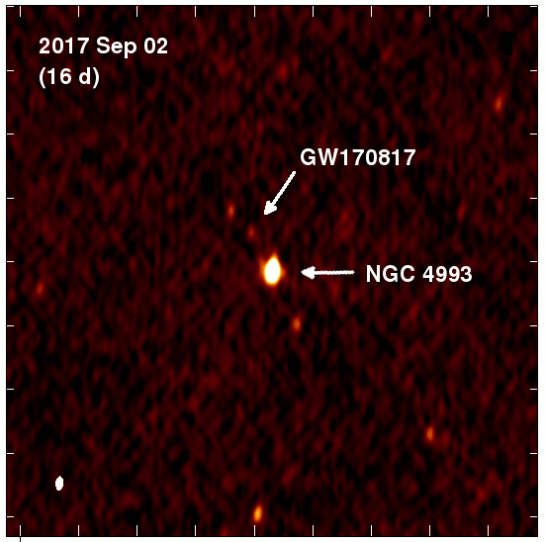
Radio follow-up of GW170817 – first detection
Started searching at t = 10 hours
(ATCA first radio telescope observing)
Initially targeted list of galaxies
Then daily observations of NGC 4993
(distance 41 Mpc)
Radio detection at t = 16 days
VLA detections:
Sept 3rd 3 GHz = ~19 𝜇Jy, 6 GHz = ~28 𝜇Jy
ATCA detection: Sept 5th 7.25 GHz = ~25 𝜇Jy
Hallinan et al. (2017), Science, 358, 1579 Image credit: David Kaplan
Notes:
Excitement back in 2017 – detection of first neutron star merger
Predictions from prompt emission through to months/years
Early non-detection is important for modelling
Two EM sources
1)
Bright optical/UV, faded after a few days, then redder emission that lasted weeks
Consensus is that this is a kilonova powered by dynamic ejecta
Radioactive decay of r-process nuclei
2)
Prompt emission in gamma-rays, non-thermal emission detected in X-ray and radio several weeks later
Took longer to confirm what causes this afterglow
Early observations let us rule out two possibilities

Slide 3
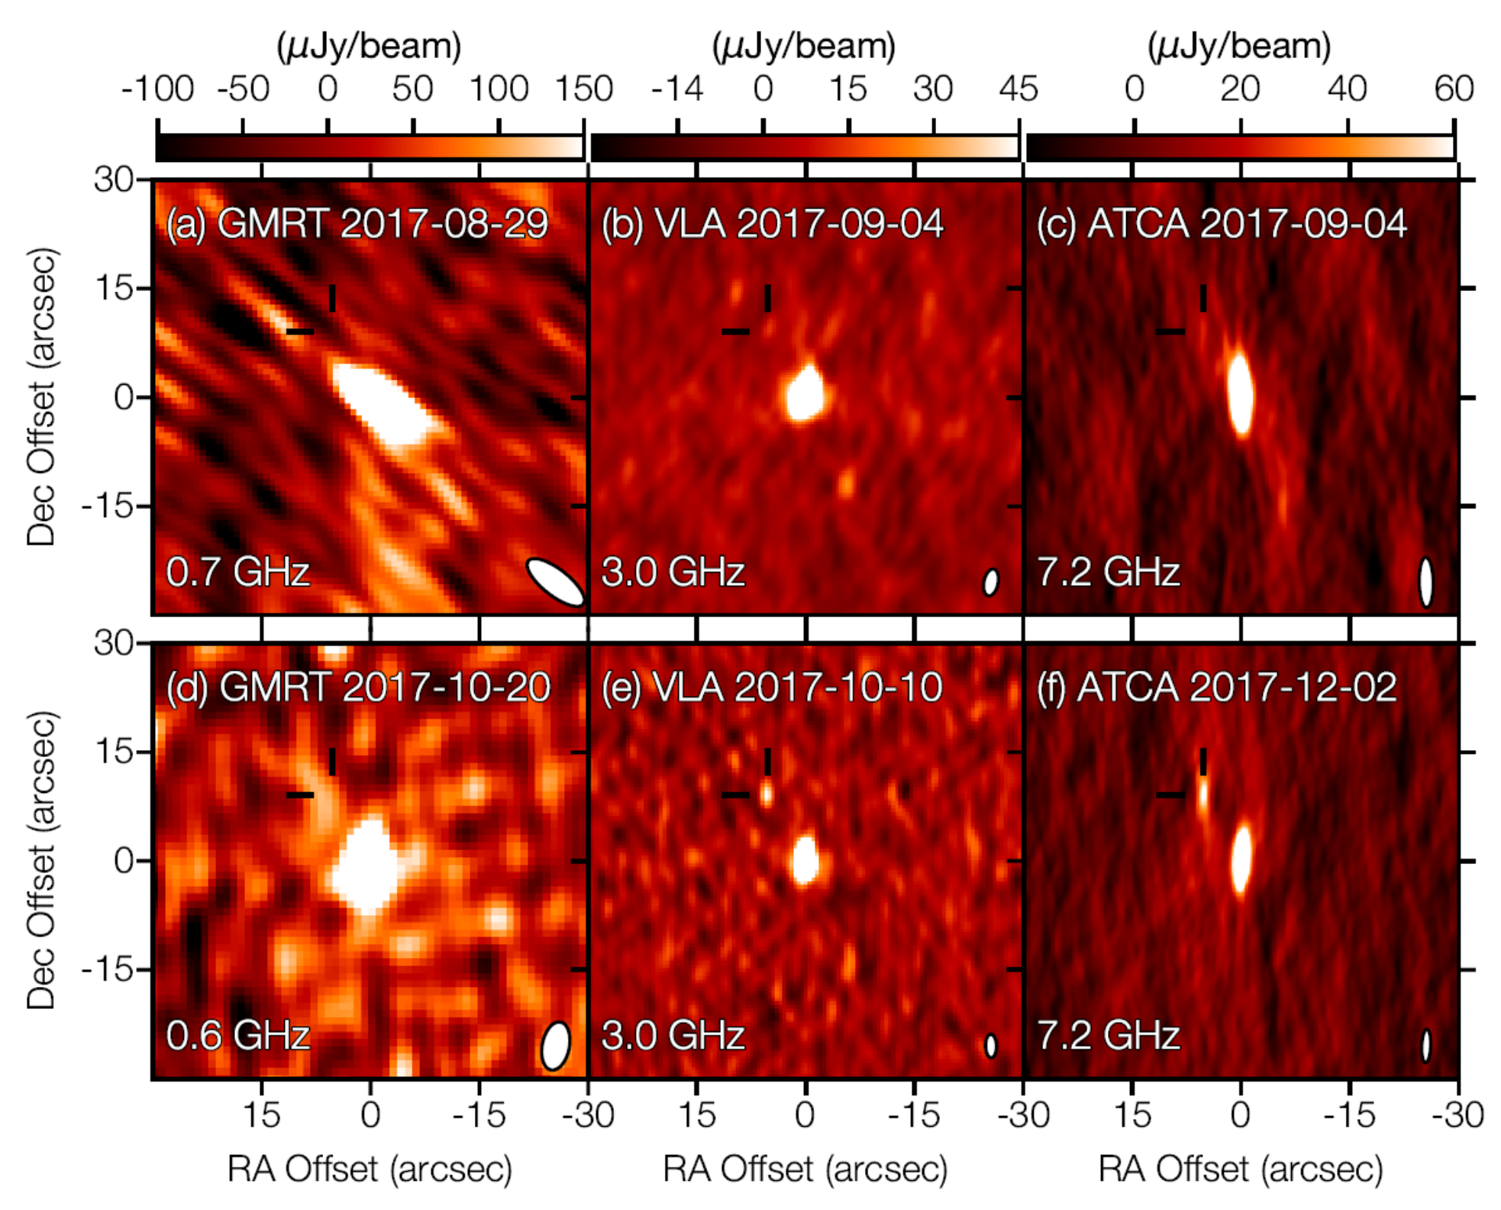
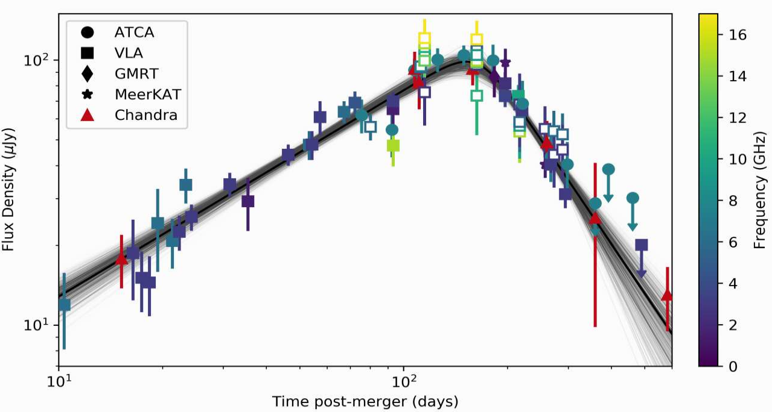
4.
Ongoing radio & X-ray monitoring of GW170817
Peak at ~170 days post-merger
X-ray
Troja et al. (2019), MNRAS, 489, 1919
Piro et al. (2019), MNRAS, 483, 1912
Mooley et al. (2017), Nature, 554, 207
Dobie et al. (2018), ApJL, 858, 15
Mooley et al. (2018), ApJL, 868, 11
Notes:
No evidence of spectral index evolution – optically thin synchrotron emission
Peak: ~170 days post-merger
Key goal of radio monitoring is to understand physical
Analytic / semi-analytic and numerical models; fit to light curve
Critical: sharpness of peak and slope of power-law decline depend on viewing angle and jet opening angle.
Gives us physical parameters like
the jet opening angle
the density of the interstellar medium
the isotropic-equivalent energy of the merger

Slide 4
4.
X-ray and radio GW follow-up projects
GW170817 X-ray observations. Early non-detections on:
  MAXI (Sugita et al. 2017)
  Swift-XRT (Evans et al. 2017) – 0.6 days post event, daily obs.
  Chandra (Margutti et al. 2017) – 2 days post event
Then detected at 9 days post event
  Chandra (Troja et al. 2017) – 9 days post event
  Chandra (Haddard et al. 2017) – 9 days post event
GW170817 radio observations. Followed up with:
VLA (Corsi et al. Alexander et al.), ATCA (Dobie et al. Troja et al.), uGMRT (Mooley et al.); MeerKAT (Camilo et al.), ALMA (Alexander et al.)
Low freq: GMRT (Mooley et al.), MWA (Kaplan et al.), LWA1 (Callister et al.)

Slide 5
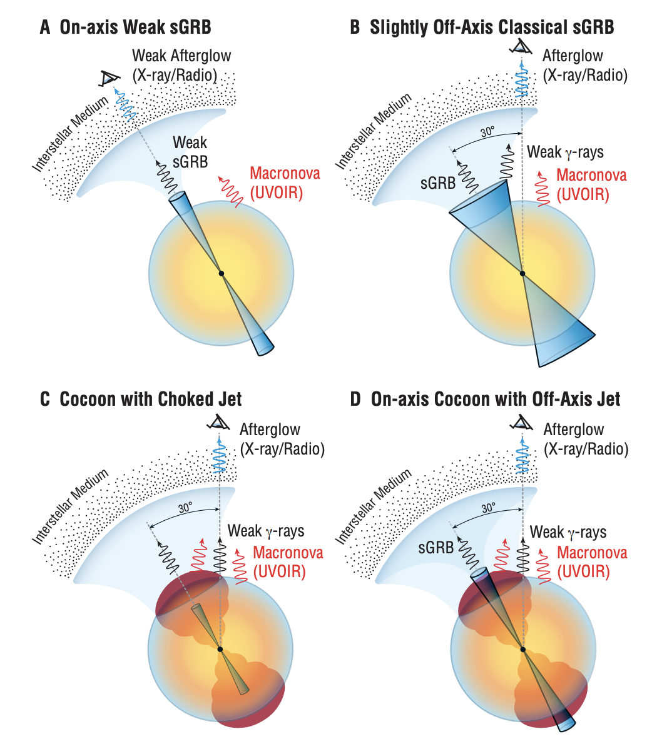
Radio & X-ray observations constrain merger models
Classic sGRB is a jet in the line-of-sight
Narrow; ultra-relativistic
Gamma-ray luminosity 4 orders of magnitude lower than typical
  Requires ejecta mass < 3 × 10⁻⁶ M⊙
  UVOIR ⇒ 0.05 M⊙
S1: Wide-angle jet ⇒ jet is choked
  Radio emission from forward shock
S2: Narrow-angle jet ⇒ jet escapes ejecta
Radio emission from afterglow
Kasliwal et al. (2017) Science, 358, 1559
Notes:
Ruled out by delayed onset of jet. Extremely weak sGRB, then the successful breakout of a narrow,
ultra-relativistic jet would require <3×10-6 M⊙ of material ejected in the direction of the jet
Contradicted with the observed bright UVOIR counterpart indicating ≈ 0.05 M⊙ of ejecta
2) Expect bright afterglow at all wavelengths when the external shock decelerates to Γ ∼ 10 roughly one day later.
Slow rise rules this out
Leaves two possible models. Gamma 100 interacts with gamma 4 cocoon
Both scenarios launch an ultra-relativistic jet that interacts with the neutron-rich material dynamically ejected during the merger
Radio light curve alone not enough to rule these out.
Piro et al. – merger remnant

Slide 6
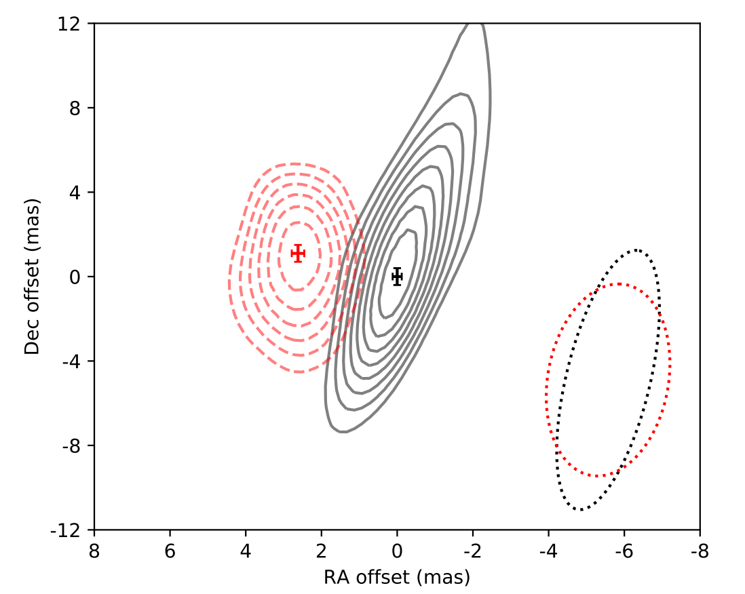
VLBI direct imaging results
3-12σ contours of the radio counterpart to GW170817
Black - 75 days post-merger
Red - 230 days post-merger.
Unresolved:
<1 mas (0.2 pc) ⟂
<10 mas (2pc) ∥
Rules out isotropic ejecta: emission likely jet-dominated
Viewing angle: ~20 deg
Jet opening angle: ≲ 5 deg
Mooley, Deller, et al. (2018), Nature, 358, 1559
Notes:
Jet dominated – see proper motion as jet expands
Cocoon dominated – almost no proper motion as emission isotropic
Jet survives and produces a structured outflow
Cocoon-dominated at early times
Jet-dominated at late times
Local n~10⁻⁴ to few×10⁻³ cm⁻³
Explosion E~10⁴⁹⁻⁵⁰ erg
Good news for EM counterparts
Cocoon is visible over a wider solid angle than a narrow jet
Direct proof that SHBs are generated by NS mergers
Rate of SHB ~ NS/NS rate
Need another 15 events with VLBI to reduce uncertainty to 2-3%

Slide 7
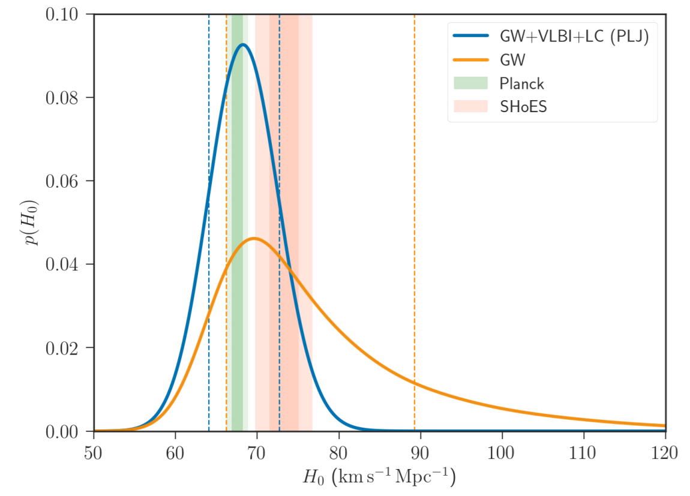
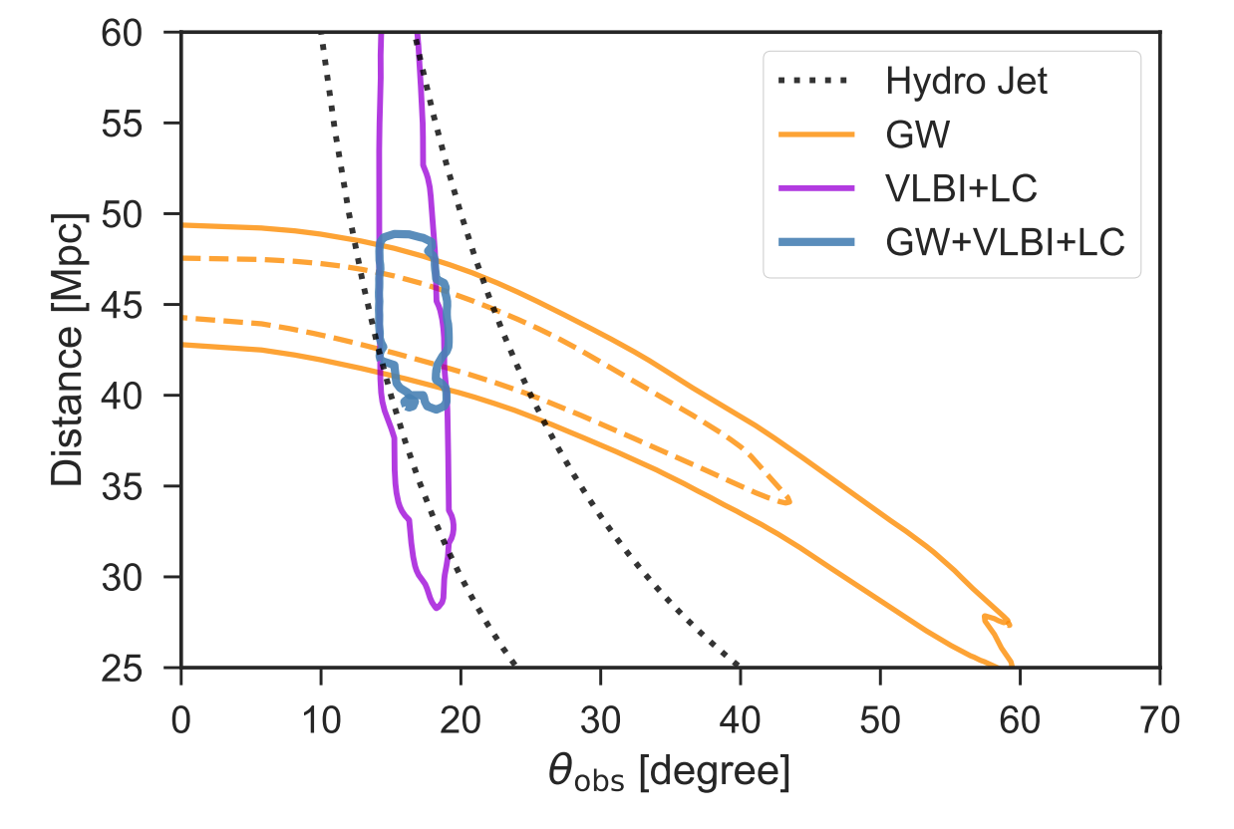
VLBI – independent estimate of Hubble Constant
Abbott et al. (2017): H₀ using standard siren:
  Compare distance from GW strain directly to redshift of host galaxy
  Uncertainty due to peculiar velocity and distance/inclination degeneracy
Hotokezaka et al. (2018), arXiv:1806.10596
Decrease uncertainty by factor of 2-3 by constraining inclination and distance with radio observations
More sources improves this further
Notes:
Hubble flow velocity – velocity due to expansion of the Universe
Recessional velocity (from EM spectroscopic redshift)
Distance – usually from cosmic distance ladder
Net velocity – have to take into account “peculiar velocity” on top of that
Usually have to use the cosmic distance ladder, with something like the Tully Fisher relation
(relationship between intrinsic luminosity and emission line width / angular velocity)
At nearby distances all cosmological distance measures differ only by vH/c (~1%)
Optical id of NGC 4993 is independent of H0
We know position, redshift
Take into account peculiar velocity of nearby galaxies
SHOES – Type Ia SN
Plank CMB
“standard siren” analogous to standard candle
Need another 15 events with VLBI to reduce uncertainty to 2-3%

Slide 8
Radio follow-up in O3 and beyond
Notes:
10 MINS
So what does radio tell us?
1) How much energy do binary neutron star (NS-NS) mergers release?
2) How many binary neutron star mergers have relativistic jets?
3) What is the relationship between binary neutron star mergers and short gamma-ray bursts?
4) What will a neutron star–black hole (NS-BH) merger look like?

Slide 9
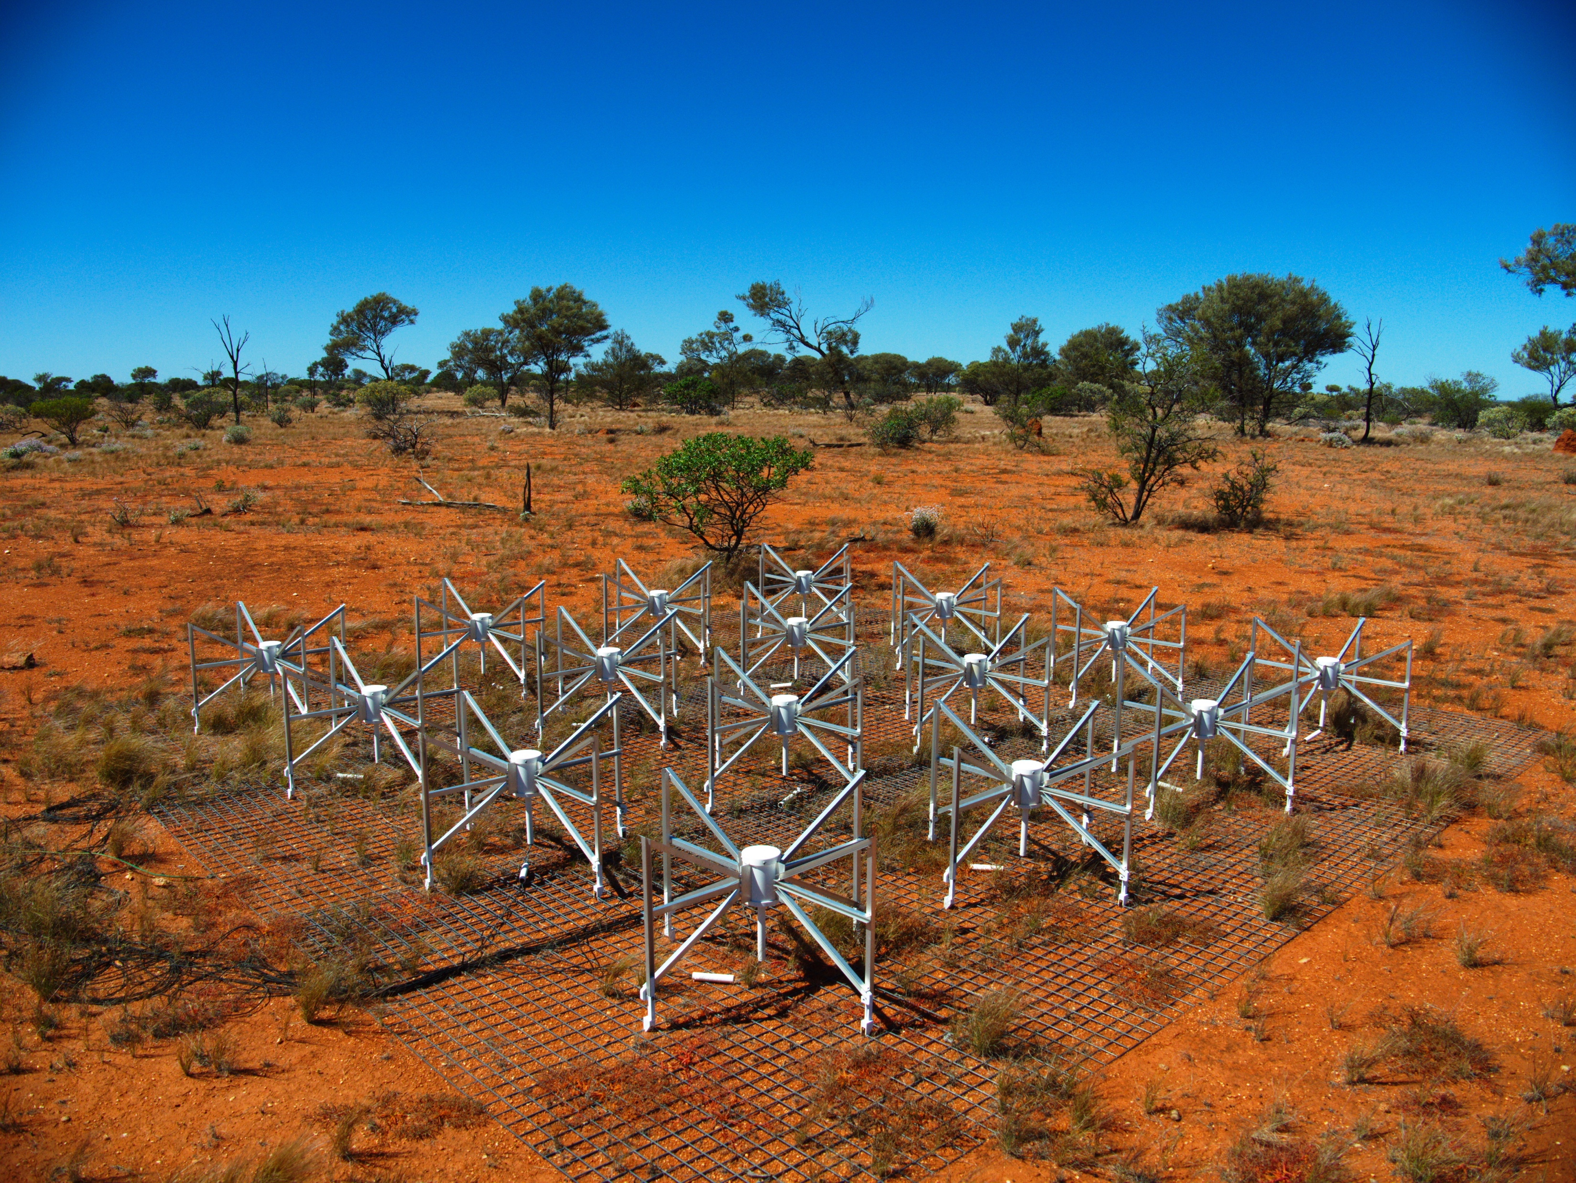
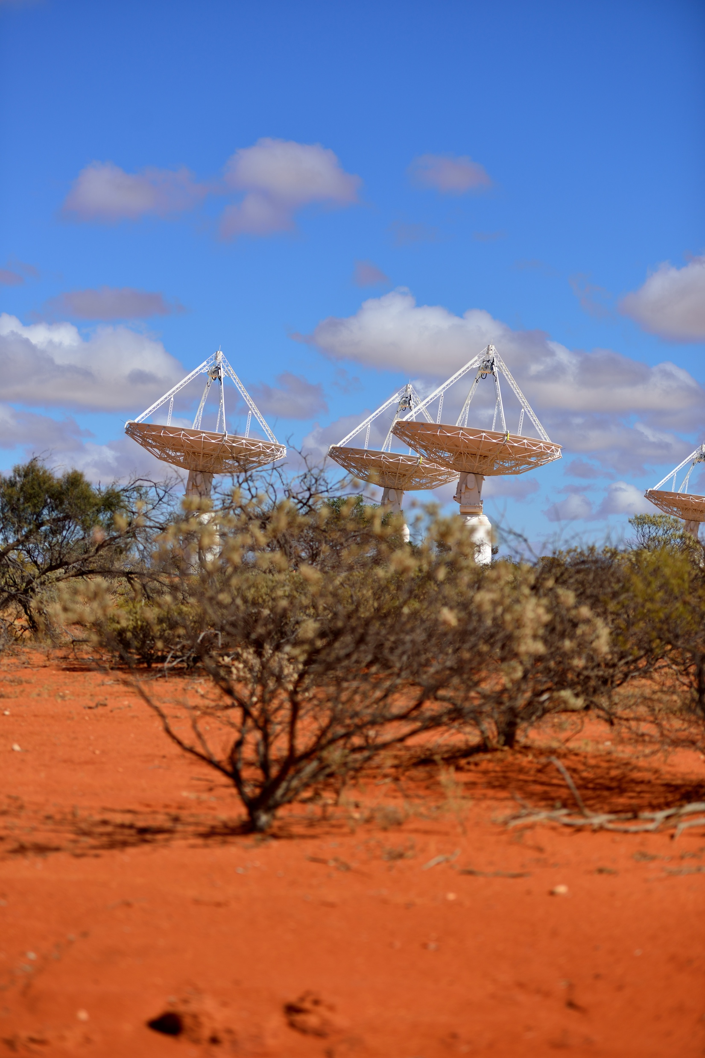
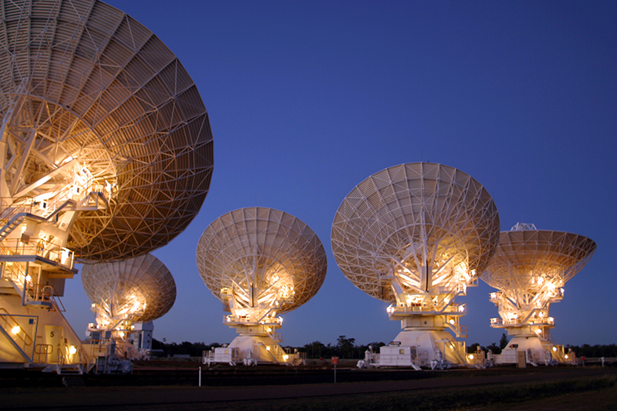
Radio telescopes in our GW follow-up program
Notes:
1) Australia Telescope Compact Array (ATCA) observing program
750 hours allocated over 5 semesters
Strategy 1: galaxy targeting using CLU (Cook et al. 2017)
Strategy 2: targeting candidate counterparts detected in other bands
Strategy 3: long term monitoring of counterparts
2) Australian Square Kilometre Array Pathfinder (ASKAP) observing program
100 hours – pilot survey for radio transients
100 hours – GW time for follow-up when localization is poor
3) Murchison Widefield Array (MWA) observing program
Automatic triggering with latency 10s to ~1 minute
May also search for long time scale afterglow – weak at low freq.

Slide 10
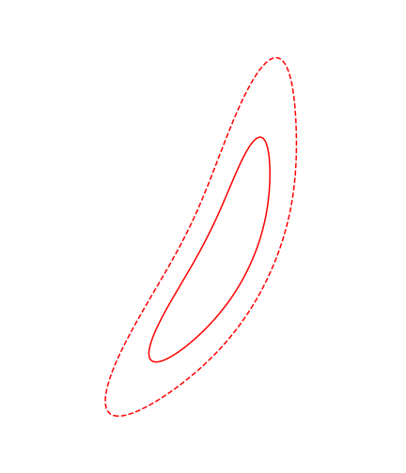
1. ASKAP is ideal for source localization
Animation of tiling algorithm
First LIGO events localized to 520 – 1600 deg²
First LIGO/Virgo event localized to 60 deg²
GW170817 localized to 28 deg²
ASKAP field of view is 30 deg²
Median for O3 is expected to be 150 deg²
ASKAP will be ideal when:
  There is no identified EM counterpart;
  GW localization is poor;
  Source is in Southern sky (<+30º Dec);
Investigating optimal tiling strategies for ASKAP
Dobie et al. (2019), PASA, 36, 19

Slide 11
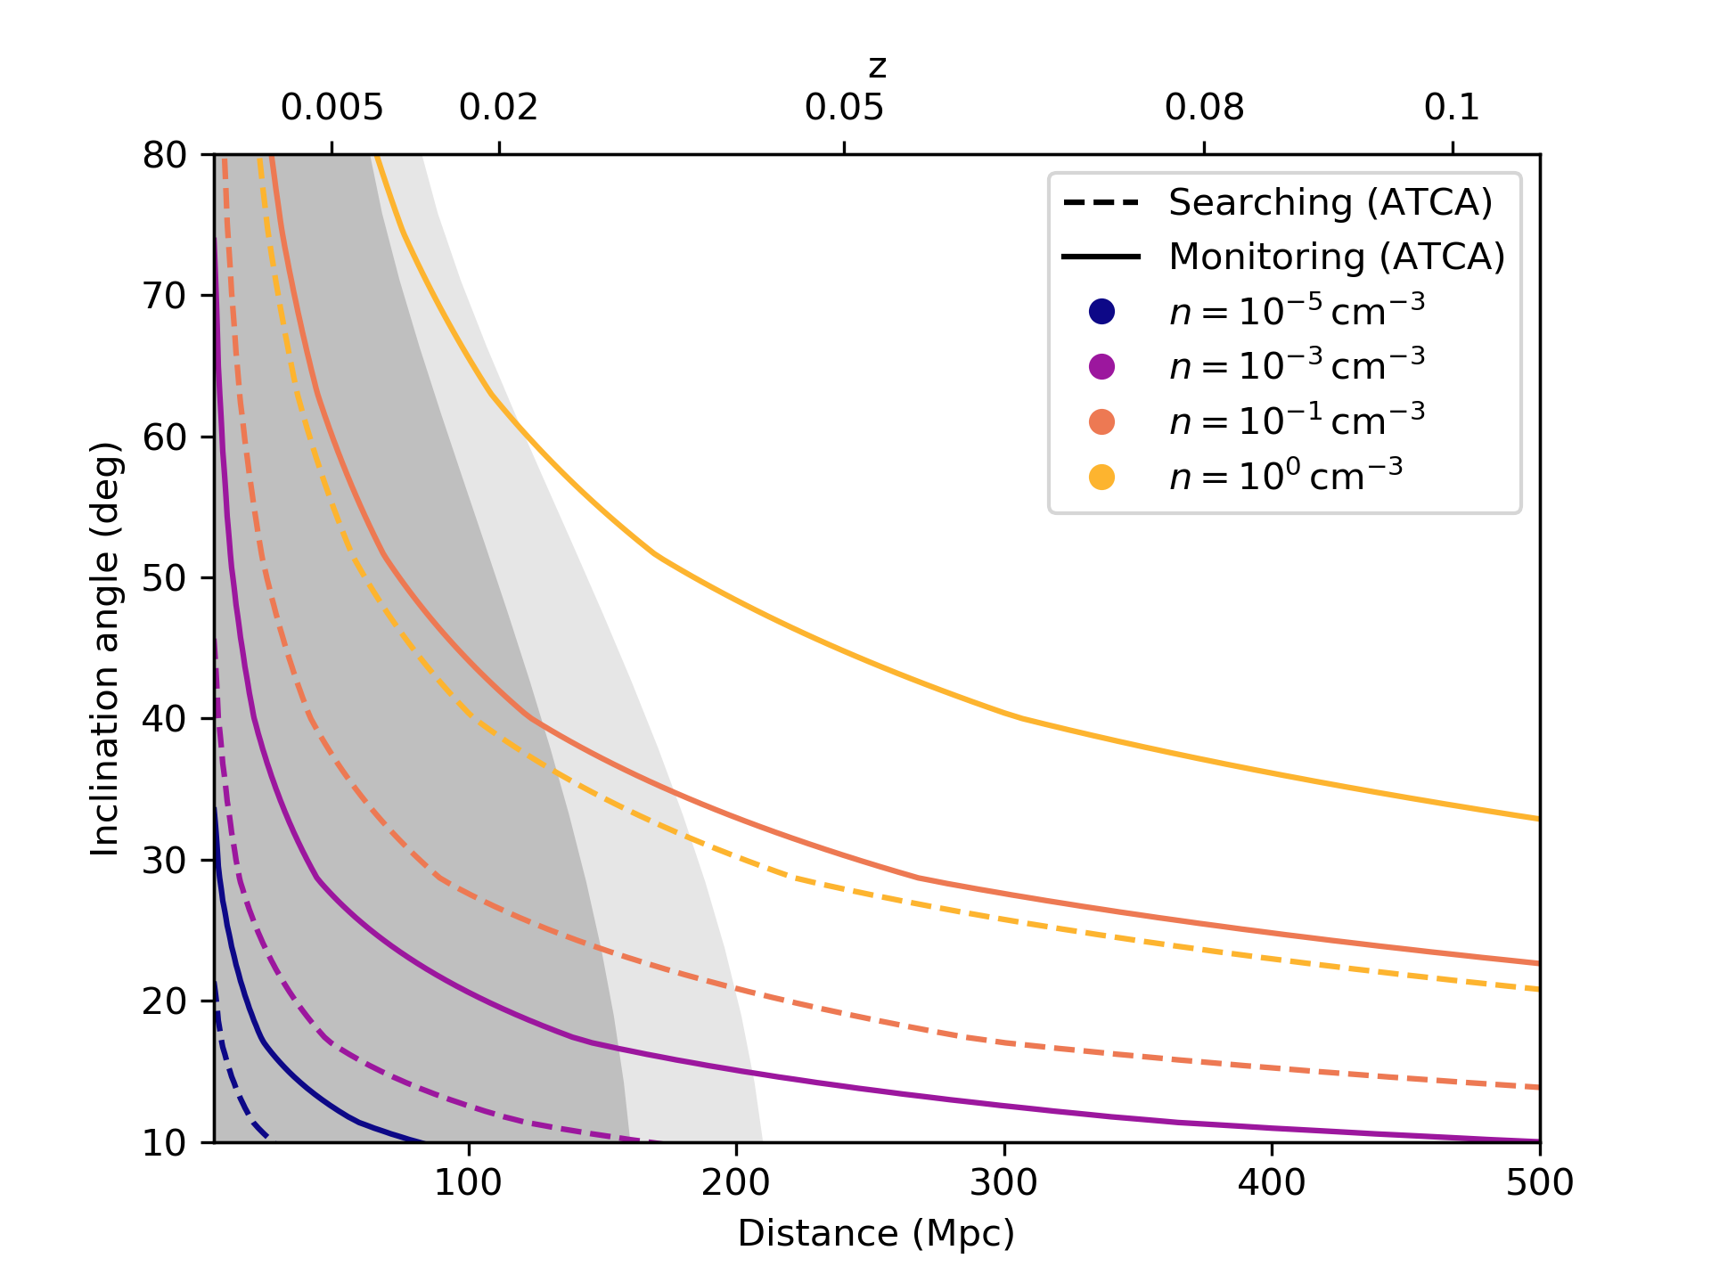
2. Radio monitoring of NS-NS and NS-BH mergers
Sensitive observations with narrow field-of-view telescopes (VLA, ATCA)
ATCA: 750 hours over 2 years
Detectability depends on:
inclination angle
distance to host
density interstellar medium
NS-NS: maybe ~1 per month
NS-BH: maybe ~2-3 over O3
Dobie et al. (2019), in prep
Notes:
Detectable range of a NS-NS merger radio afterglow with the ATCA as a function of distance, inclination angle and circum-merger density
7.5 GHz
Detection: searching for an EM counterpart by targeting candidate host galaxies 10 mins (detectability limit ~ 180 uJy)
Monitoring: counterpart detected at other wavelengths with 12 hour observations (detectability limit ~ 20 uJy).
Parts of the phase space to the lower-left of each contour are detectable.
Radio lightcurves are simulated according to a power-law jet model using an E_iso comparable to GW170817. Masses and mass ratios are not considered,
The shaded region shows the estimated detector horizon for O3, using an average horizon of 145 Mpc
The range for the VLA is ~1.5 times further.

Slide 12
3. VLBI – expansion and superluminal motion
Aim to detect expansion and superluminal motion through:
VLBI observations
Interstellar scintillation
Dobie, Kaplan, Hotokezaka et al. (2019), submitted
Notes:
Angular size , centroid offset and 3GHz flux density (bottom) for a neutron star merger at a distance of 40Mpc
with a circummerger density of n = 0.01cm−2 for a range of inclination angles.
The angular size, offset and flux density detectability thresholds of 0.35mas, 0.8mas and 15μJy respectively are denoted by dashed red lines.
Lightcurve for a neutron star merger afterglow at a distance of 40Mpc,
an inclination angle of 30deg and circummerger density 0.01cm−2.
The shaded region corresponds to the expected levels of variability introduced by refractive interstellar scintillation.

Slide 13
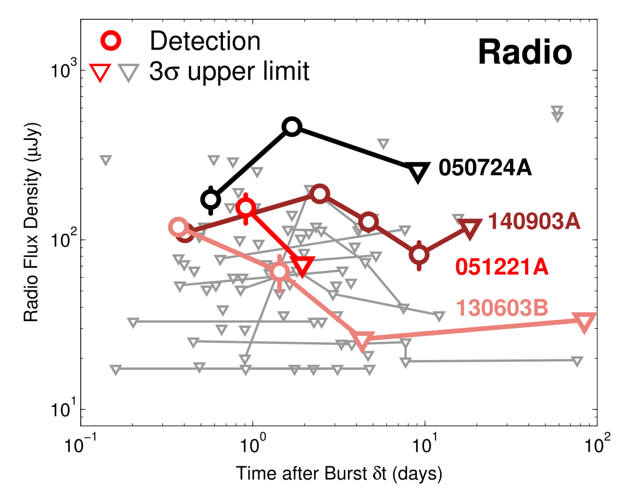
4. Unbiased surveys for orphan afterglows
Example 100 hour ASKAP pilot survey for GRB/GW orphan afterglows:
4 epochs (months apart)
5 min observations
5 sigma rms = 1.4 mJy
Area = 8390 square degrees
Fong et al. (2015), ApJ, 815, 201
Dobie et al. (2019), PASA, 36, 19
Notes:
Until GW170817 – 4 short GRBs detected in radio
Plot on right shows GW170817 would be detected by ASKAP in blind survey
Also possibility of detecting sources not detected in optical

Slide 14
LIGO O3: Results so far
Radio follow-up for
S190510g
S190814bv
Notes:
Too far north or poorly localised

Slide 15
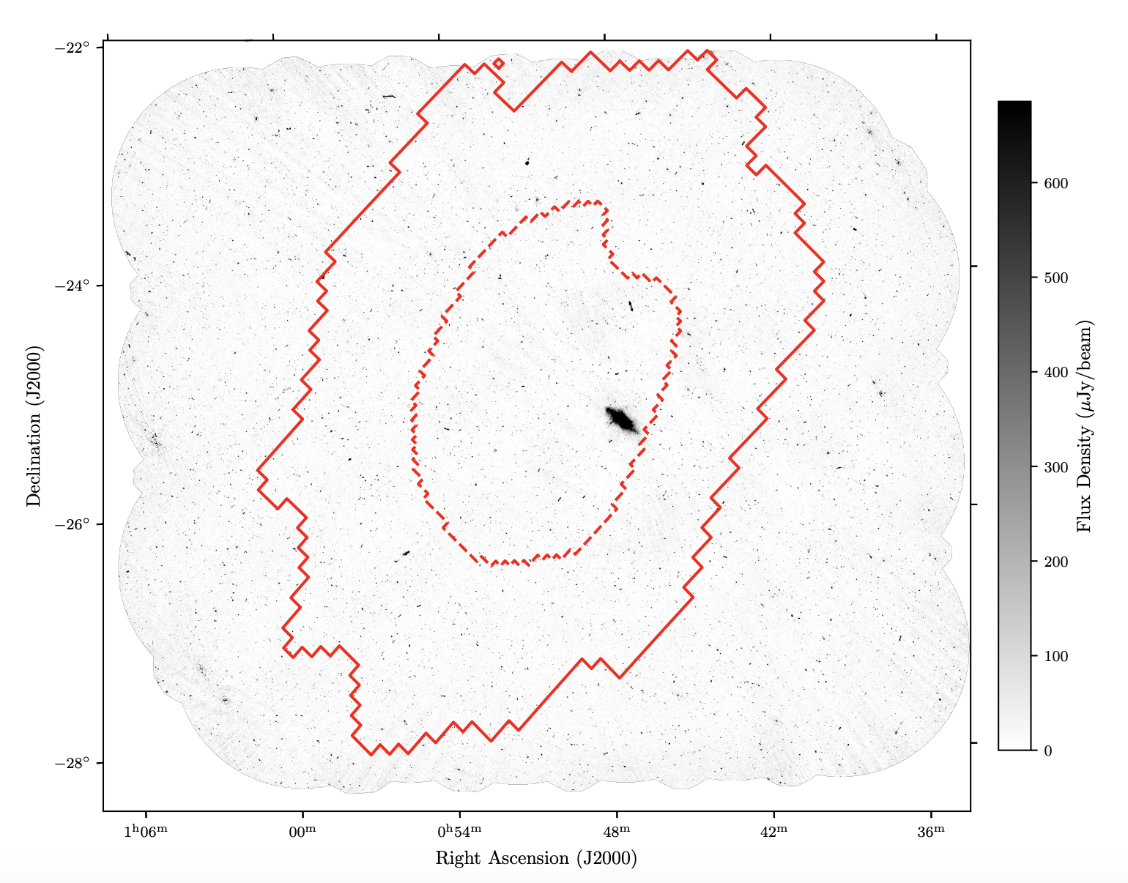
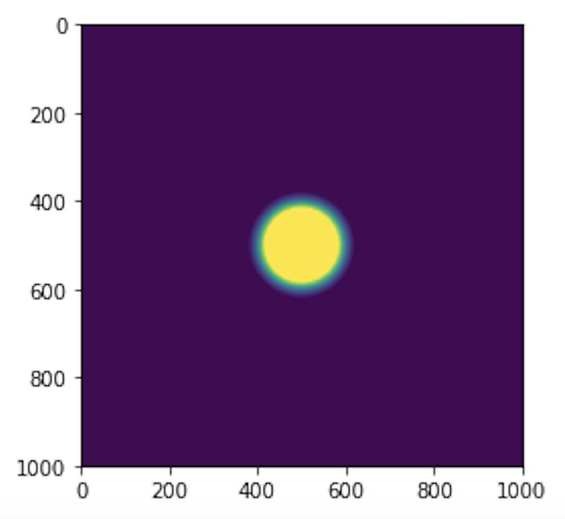
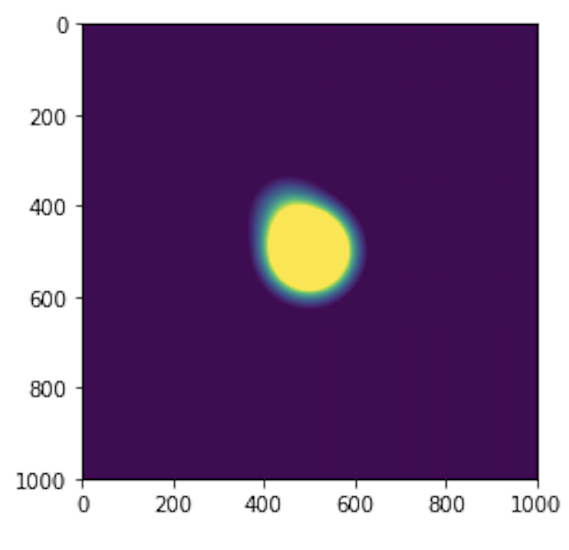
LIGO O3: ASKAP observations of S190814bv
RACS as basis: rms ~400 𝜇Jy
4 epochs: 2, 9, 33, 86 days post merger
10.5 hr obs: rms ~35 𝜇Jy
Strategy 1: unbiased search for transients in error circle
Strategy 2: targeted search of optical galaxies within the localization volume
NGC 4993 + GW170817 at ASKAP resolution
Dobie at al. (2019), ApJL, 887, L13
Notes:
19k sources in field above 5 sigma
Number of radio matches to optical galaxies in local volume is a few 100
Low false positive rate
Contours: 25, 50, 75% confidence
4th epoch at 86 days

Slide 16
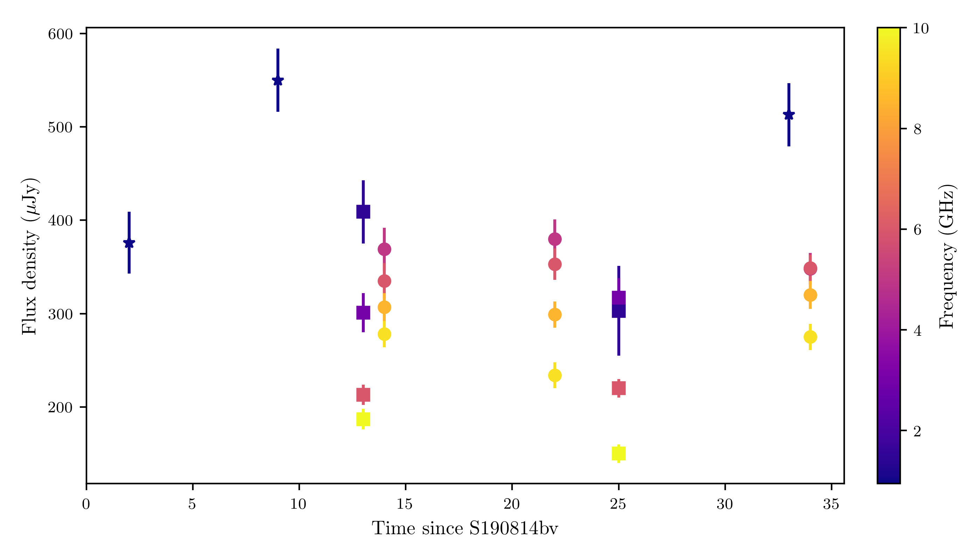
A candidate counterpart: AT2019osy
Associated with 2dFGRS TGS211Z177 (z = 0.0738)
40% rise in flux between epoch 1 & 2
Triggered multi-wavelength follow-up
No further variability
Likely low-luminosity AGN
Notes:
19k sources in field above 5 sigma
Number of radio matches to optical galaxies in local volume is a few 100
Low false positive rate
Contours: 25, 50, 75% confidence
Radio important role to play
Watch this space ☺

Slide 17
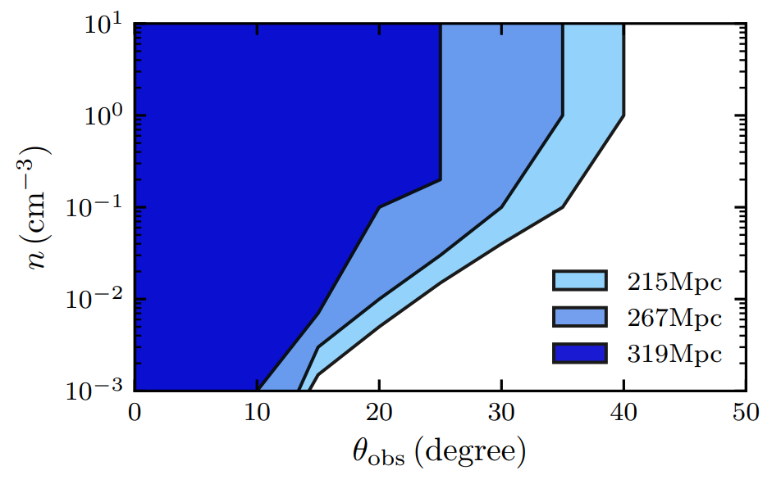
A radio non-detection is constraining
Consider radio afterglow with typical short GRB parameters (E_{iso}~10⁵¹ erg)
Early non-detections rule out on-axis
Likely to be in a denser circum-merger environment due to component masses
Dobie at al. (2019), ApJL, 887, L13
Notes:
Radio constraints on viewing angle and circummerger density

Slide 18
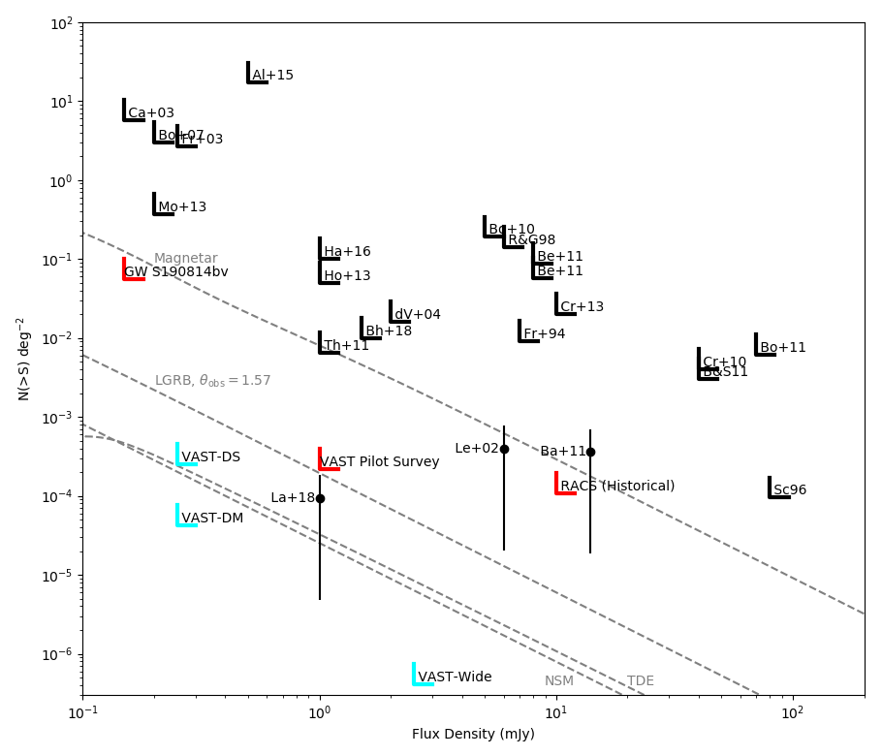
Bonus: transients survey
Follow-up of S190814bv
also best high sensitivity transients survey
RACS (10 min)
+ 4 x 10 hr integrations
Typical RMS = 34 uJy
0.7% highly variable sources
(changes > 30%)
Stewart et al. (2020), in prep

Slide 19
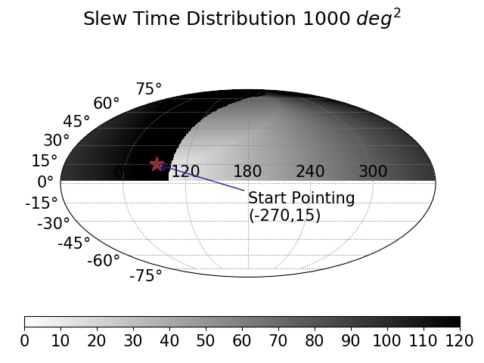
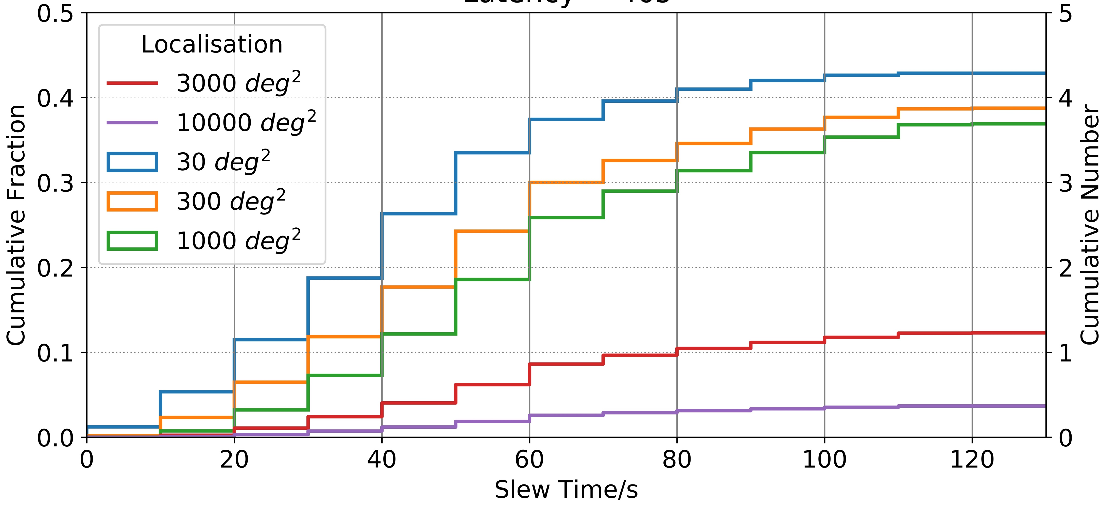
LIGO O4: Can we detect prompt radio emission?
Possible connection between FRB-like emission and GW events
From O4 negative latency triggers may be possible
Receive alert ~30-60 seconds before merger
Wang et al. in prep
Notes:
BNS merger to form supramassive neutron star that then collapses into black hole
Magnetosphere of neutron star merger released as black hole swallows neutron star – fraction of that energy enough to explain FRB.
FRB rates much higher than GW rates, can’t explain all.

Slide 20
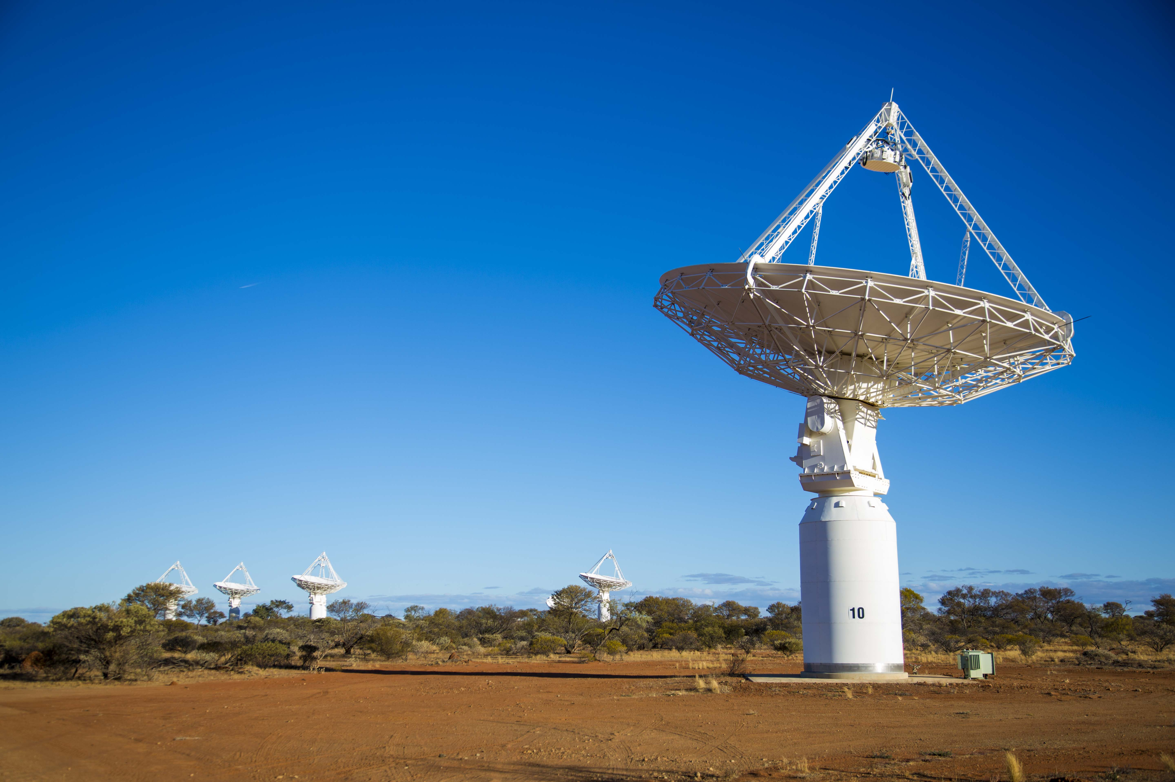
Future plans
Radio & X-ray follow-up constrains physical parameters of mergers
Track interaction with circumburst / interstellar medium
X-ray → help determine nature of merger remnant
Radio capabilities for O4:
  Targeted follow-up of candidates
  Untargeted coverage of localization area
  Possibility of response to low latency triggers
Credit: CSIRO
Notes:
ASKAP can do follow-up and (relatively) rapid processing (24-48 hours from observing to public release)
Also most sensitive widefield transients survey to date

Slide 21
Extra slides

Slide 22
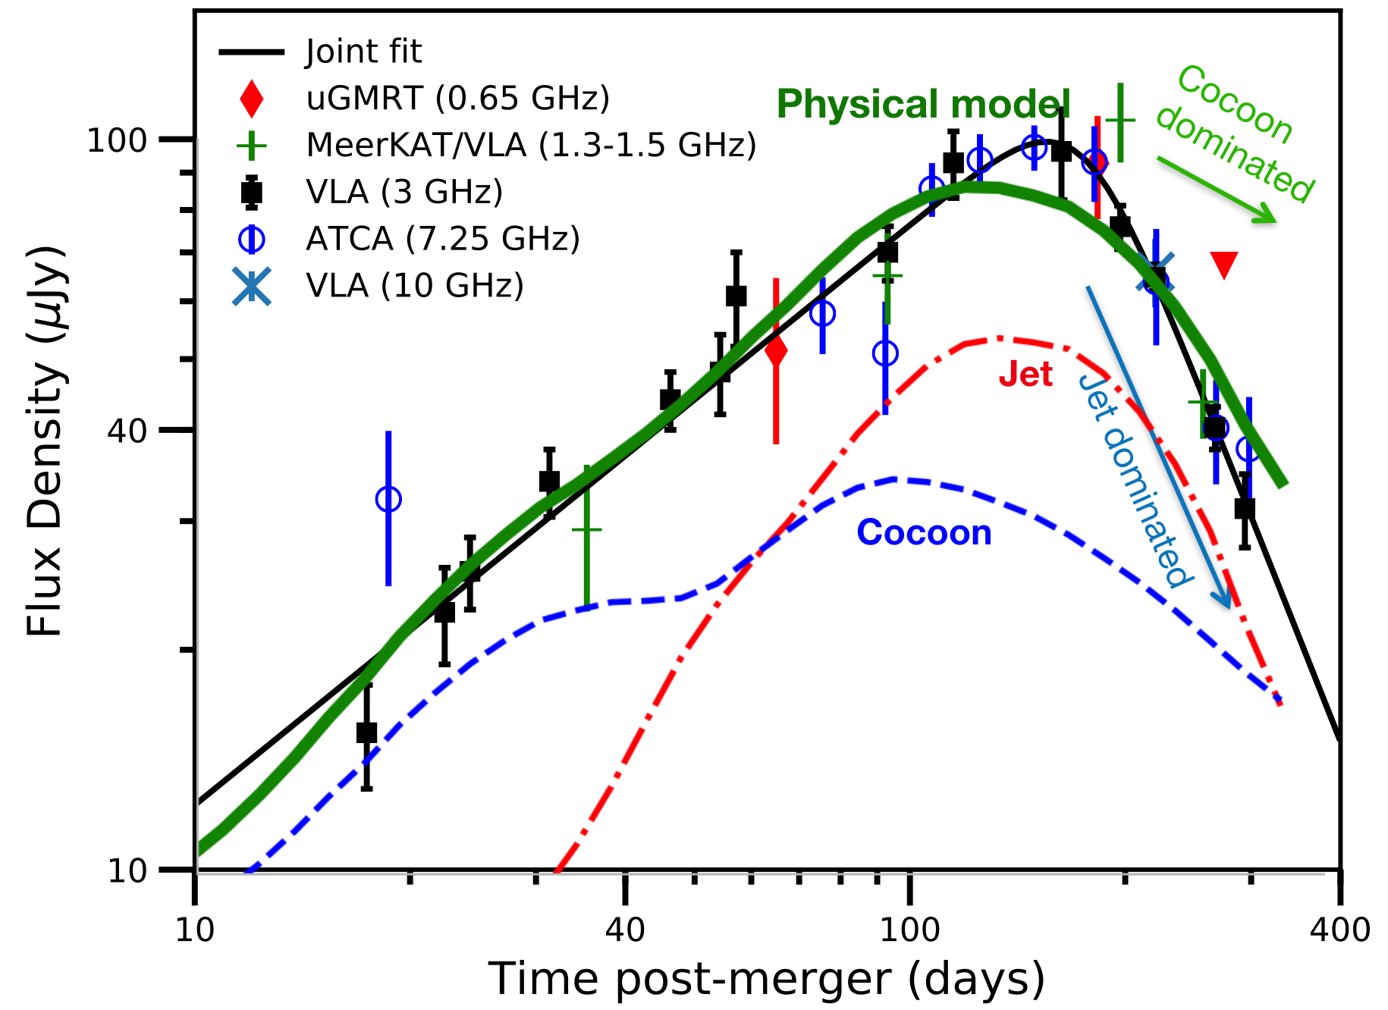
4.
Late-time monitoring is key to physical modelling
Semi-analytic and numerical model fits give:
Jet opening angle
Density of ISM
Isotopic-equiv. energy
More broad questions:
What fraction of NS-NS mergers have relativistic jets?
Relationship between mergers and sGRBs
Credit: David Kaplan, adapted from Mooley et al. (2018), ApJL, 868, 111
Notes:
Key goal of radio monitoring is to understand physical mechanisms that give rise to the electromagnetic radiation
Analytic / semi-analytic and numerical models.
observations of the radio lightcurve alone were unable to distinguish between two competing
models for the geometry of the outflow → pointed to jet

